Slide 1

Notes:
WELCOME SLIDE – suggested to leave on-screen while attendees are arriving; any opening by event host (such as prayer, pledge, announcements, etc.) are in addition to the 60-minutes for Express Training.
To complete the training in 60 minutes or less, ask attendees to hold questions until the end of the presentation. It is recommended to plan an additional 30 minutes at the end of the presentation for Q&A.
NOTE to Presenter: This slide deck is designed for a 60-minute training of hand counting basics. The notes provided for this slide deck are NOT intended to be a script. Instead, the purpose of each slide and some prompts are provided for instructors.
The eManual, the “Express Training” program, and this slide deck are authored by Linda Rantz and are copyrighted material. No use of this training program is permitted for any purpose, other than its intended purpose. For permission to use the materials for other purposes or for questions, email HandCounting@pm.me.

Slide 2

Notes:
NOTE to Presenter: Edit this slide to add your name or, “hide” it if you choose not to use it.

Slide 3

Notes:
Why return to hand counting? WHAT DO PEOPLE BELIEVE? It is not uncommon to hear friends, family, business associates, and elected officials tout that using machines is “better” than hand counting. There are “myths” about hand counting … and they are “myths” because they are “unsupported” or “untrue.”

Slide 4

Notes:
The most common myths are that it will take too long to hand count, it will cost too much because you have to pay more people, humans are not capable of repetitive tasks such as hand counting, and, even if they could, there are not enough people now – it won’t be possible to get enough people.
There will not be time in this presentation to cover “myths” individually. The video link provides some of the most common and “facts” proving that the myths are false: myths: https://handcounting.com/AboutMyths

Slide 5

Notes:
With the MYTHS in mind, should we simply trust what “they” are telling us about machines? Should we trust the machines? After all, the machines are tested … right?

Slide 6

Notes:
Retired Air Force Colonel Shawn Smith was a guest on the webinar launching the hand count system (12/29/2022). One of his comments was that the “entire regime of testing and certification that we’ve been told is protecting us is utter nonsense.” Watch the full 20-minute clip at https://handcounting.com/LaunchWebinarSmith

Slide 7

Notes:
A comprehensive plan for securing our elections and election systems may be viewed at LindellPlan.com. It covers many topics, with hand counting being one aspect. Everyone should look through the Plan and see where they fit in and how they can participate.

Slide 8

Notes:
Despite the “belief” in voting machines and the “myths” and pushback against hand counting, many people believe that we must “relearn” how to hand count elections. Which is what is being done through Cause of America. These are photos from “Train the Trainers” sessions around the country. These people are committed to learning and then going out to train others.

Slide 9

Notes:
Another important consideration is continuity of government. There are federal and state statutes requiring governments to be able to continue operations, even in the event of natural disaster, attack, pandemic, etc. That means even elections must go on. There should not be a reason for our government to tell us that an election is postponed or not possible for any reason. So, the people must learn to hand count to ensure that elections happen.
Col. Shawn Smith (USAF Ret.) of Cause of America remarked that he felt hand counting is the victory gardens of our day. During WWII, with the need to care for troops overseas and the Homefront, citizens stepped up and began planting gardens to grow food.

Slide 10

Notes:
It was then, and is now, the people who will step in to secure our country. We are calling this “Operation Victory Gardens.”
By being here today, at this Express Training, each person is helping to ensure that the people can do their part, if called upon do so.

Slide 11
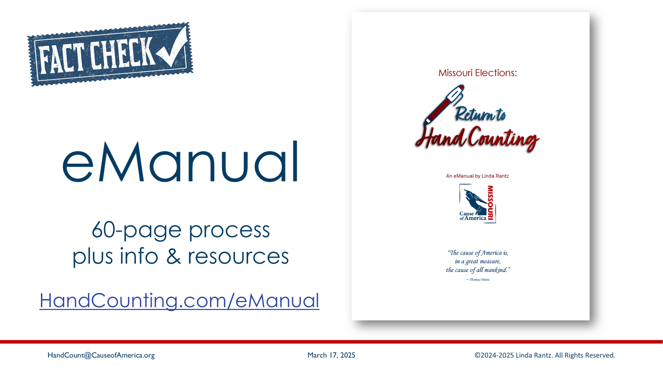
Notes:
The process being taught today is referred to as the “Missouri Model.” It was written by Linda Rantz of Missouri in response to Mike Lindell’s call to “get rid of machines.” Linda began researching an alternative to counting ballots that did not require electronic voting equipment.
From that research work, a start-to-finish hand count method was written. The process part of the eManual is 60 pages … there are another 240 pages of supporting documentation. And, unlike the “myths” about hand counting, the supporting documentation proves that this process is “fact-checked.”

Slide 12

Notes:
START the clock – it’s 60 minutes to learn hand counting!

Slide 13

Notes:
A counting team is 4 Election Judges, 2 Republicans and 2 Democrats. Two judges (1 republican, 1 democrat) will be “calling” the votes from the ballots, while the other two (1 republican, 1 democrat) tally the votes on their own individual tally forms.
For the Missouri Method, the estimate is 50 to 100 ballots per hour per counting team with 50 being the conservative estimate.

Slide 14
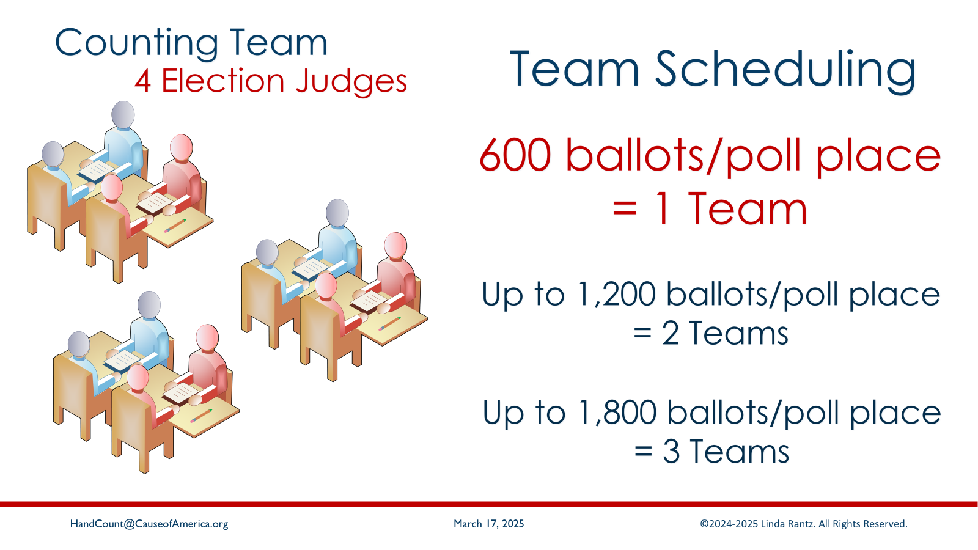
Notes:
To calculate how many teams are needed, the Clerk must anticipate the expected number of ballots to be cast at the polling place. For 600 or less ballots cast at the polling place, estimate 1 Counting Team at that polling place as a conservative estimate. Increase the number of teams for every 600 ballots expected or have extra teams to get earlier results or if the ballot is unusually long.

Slide 15
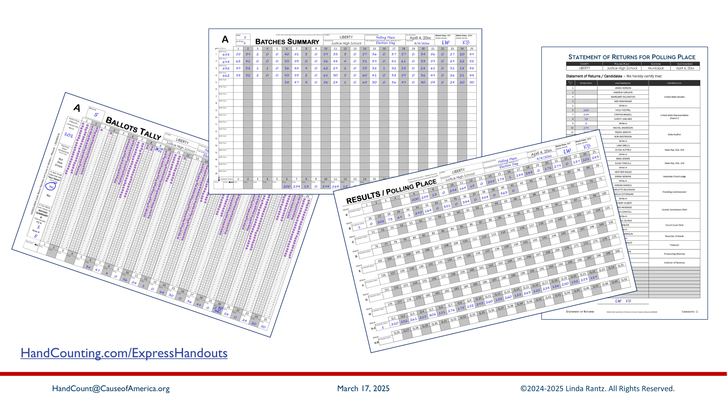
Notes:
Forms for hand count ballots at the polling place will be provided by the clerk. For Express Training, each attendees has 4 handouts: Ballots Tally form (A), Batches Summary sheet (A), Results of Polling Place, and the Statement of Returns – Candidates. Notice that the handouts are partially completed. This will allow attendees to work with these hand count forms without having to do a complete mock election.
(Forms may be downloaded from https://handcounting.com/ExpressHandouts)

Slide 16

Notes:
The first form used at the polling place to count ballots is the Ballots Tally form.

Slide 17
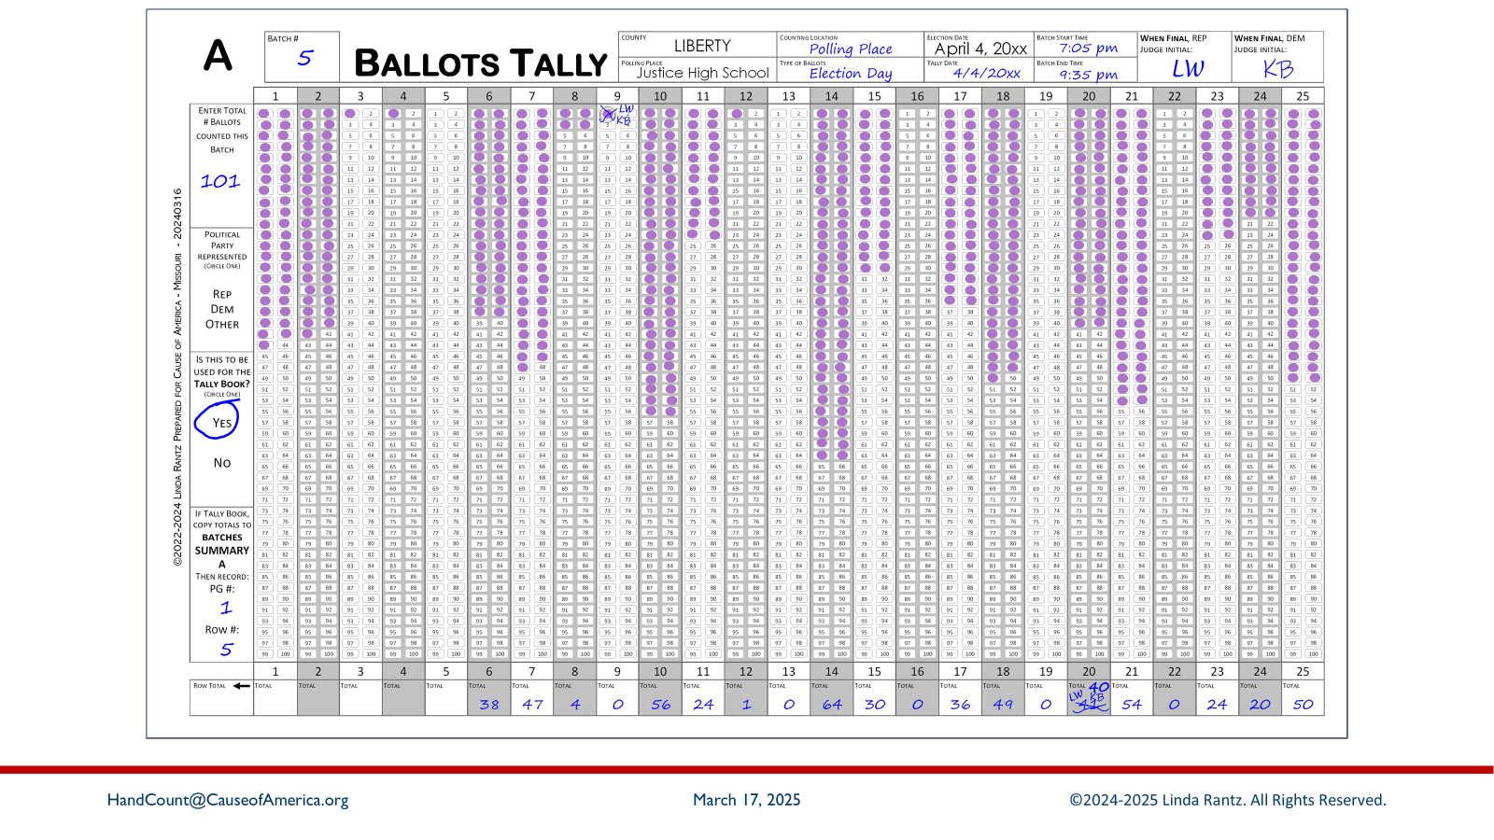
Notes:
This image matches the tally form given to attendees.

Slide 18
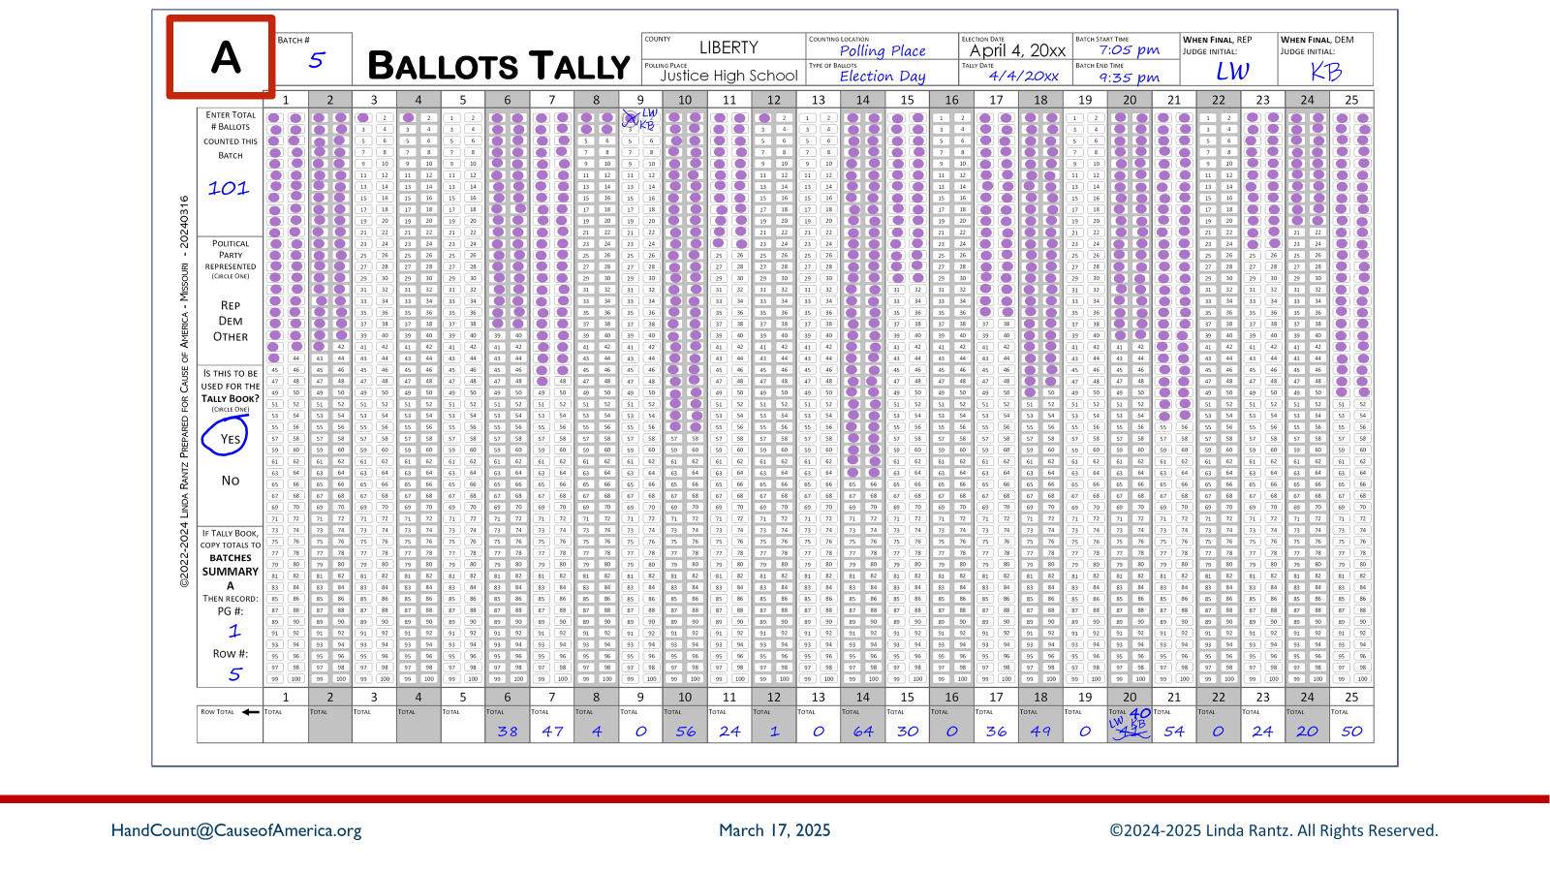
Notes:
Notice the “A” in the upper left corner. This is referred to as a “Group” identifier.

Slide 19
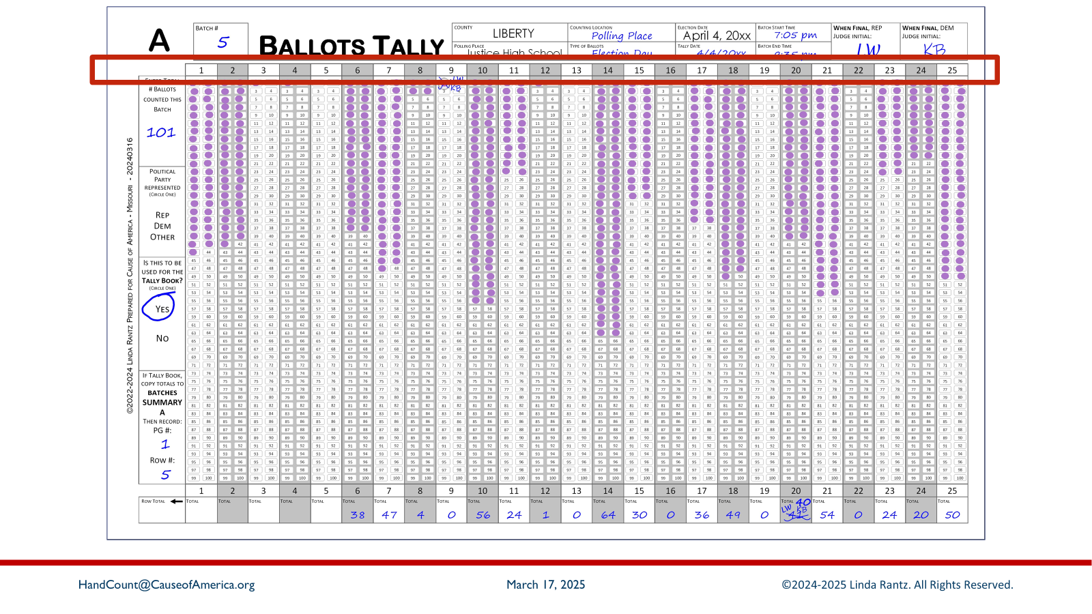
Notes:
The row of numbers near the top shows 1 through 25. These numbers make up Group “A.” Each number represents a specific candidate on the ballot and Group A is the first 25 candidates. Additional candidates are in the Group “B,” which is 26-50, and “C” (51-75), etc.

Slide 20
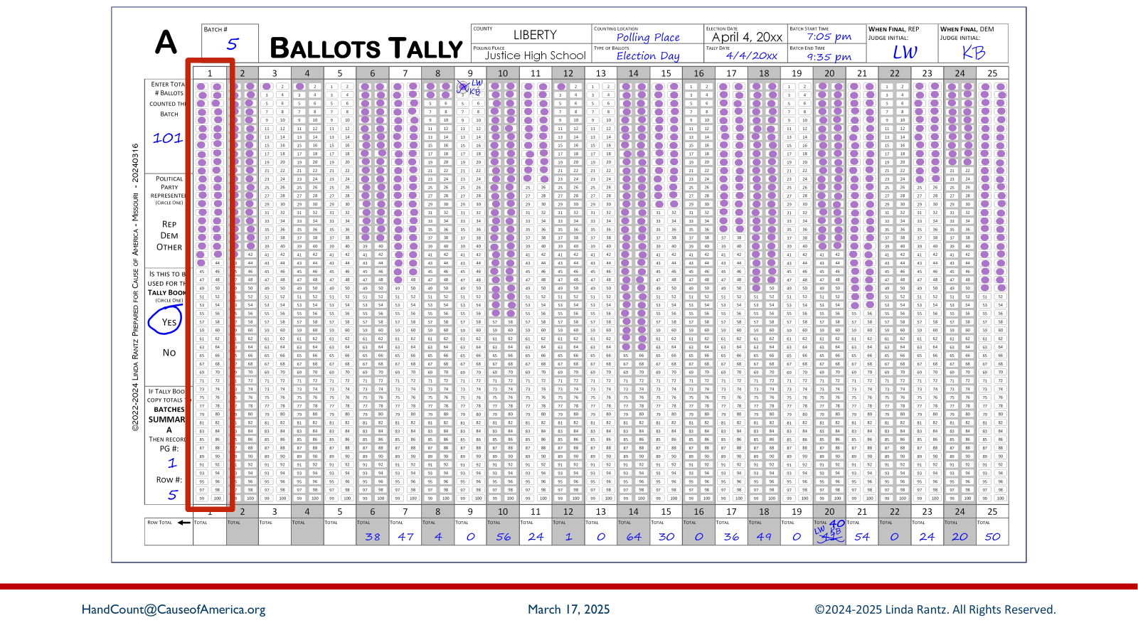
Notes:
Below each number is a column with 100 ovals. This is where the votes for that candidate are tallied. Notice the ovals already marked with a purple dot – these represent tallied votes.

Slide 21
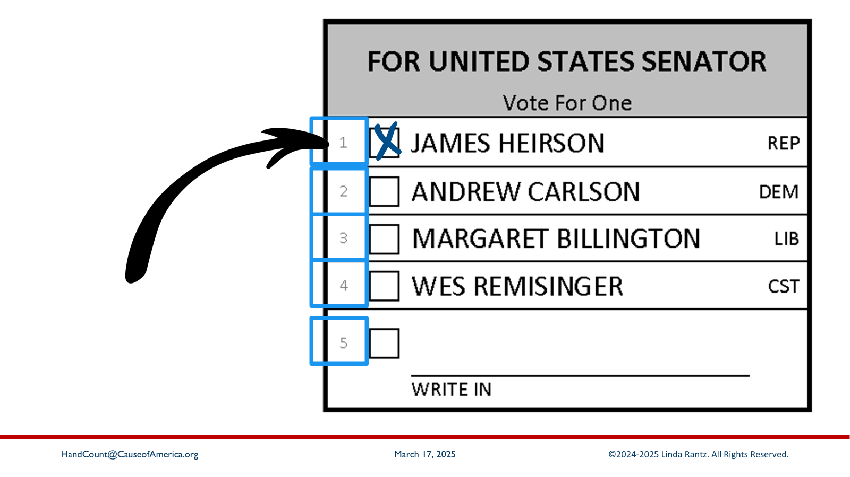
Notes:
For example, in our mock race for US Senator, these candidates were assigned numbers 1 through 5 on the ballot. You can see their numbers just to the left of the boxes for marking the vote.

Slide 22
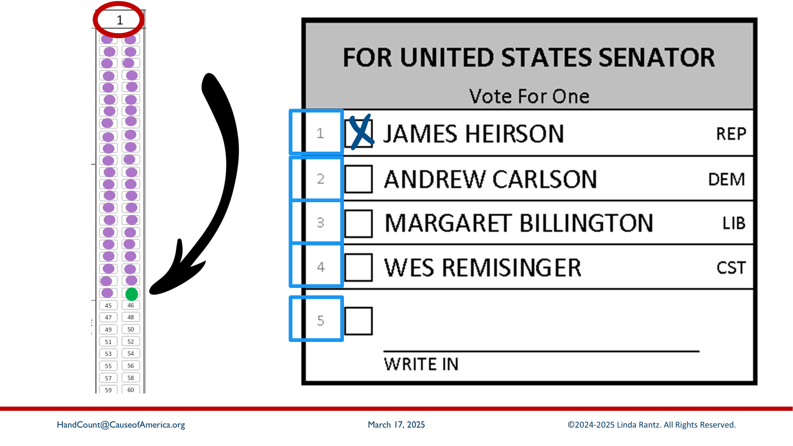
Notes:
If a vote was cast for James Heirson, the Counting Judge is going to call: “1 – Heirson – Senator.”
In response, the Recording Judges are going to take their Sharpie, find column 1, and dab the first empty oval in the column (illustrated on the slide with the green dab).

Slide 23
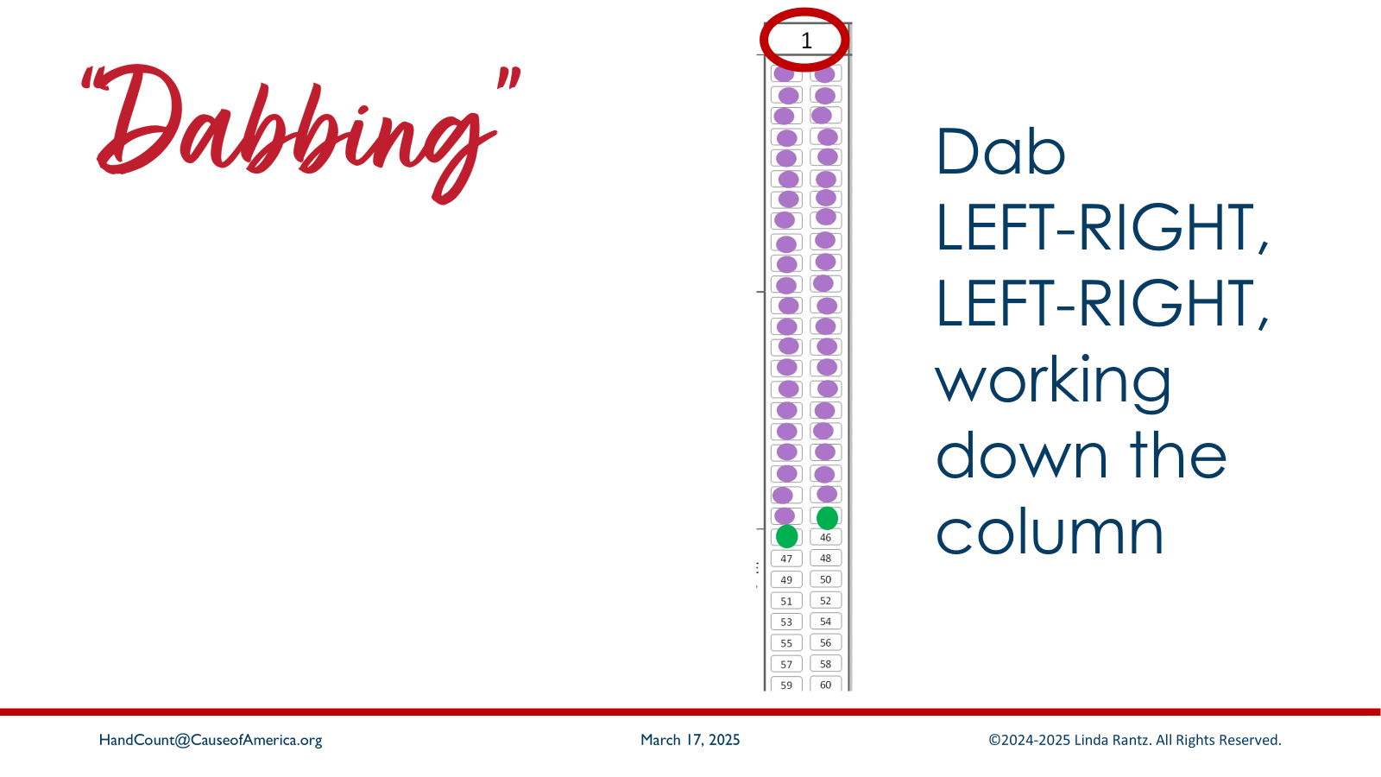
Notes:
The method for “dabbing” or tallying the votes is to “dab” (tally) left to right and work down the column.

Slide 24
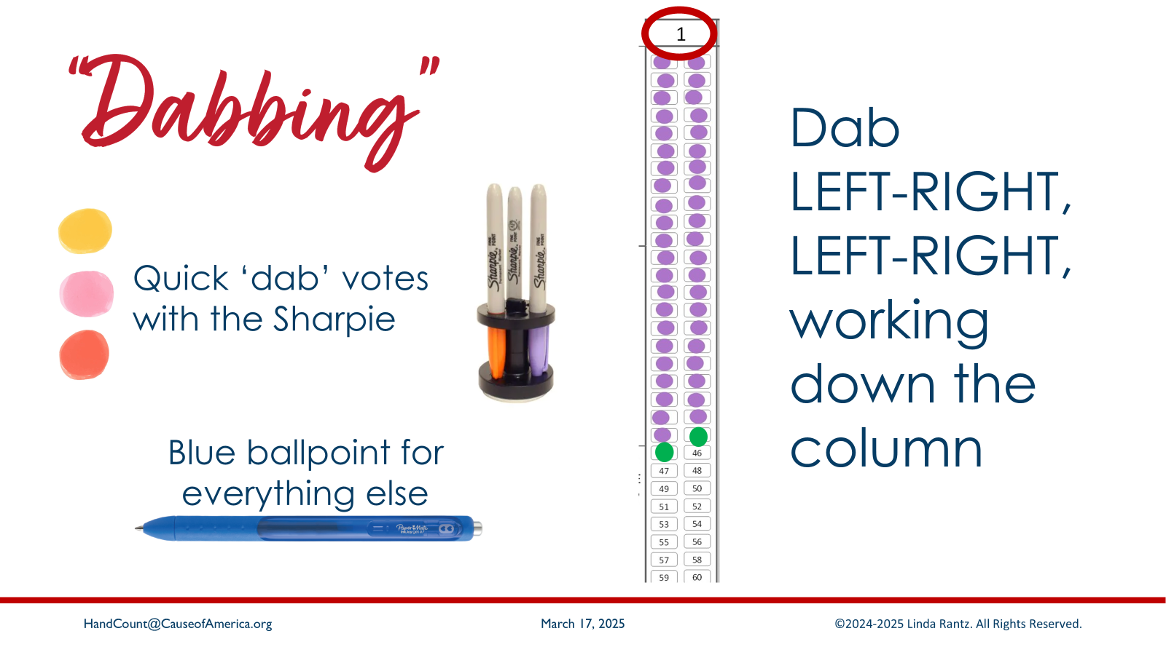
Notes:
“Dabbing” is the only time Sharpies are used. For speed and efficiency, be sure to “dab” (touch quickly) – don’t waste time filling in ovals. Notice that any other markings on this and other forms is done with blue ballpoint pen. (Ballpoint is recommended over gel-type pens, because ballpoint tends to leave an impression on the paper.)

Slide 25
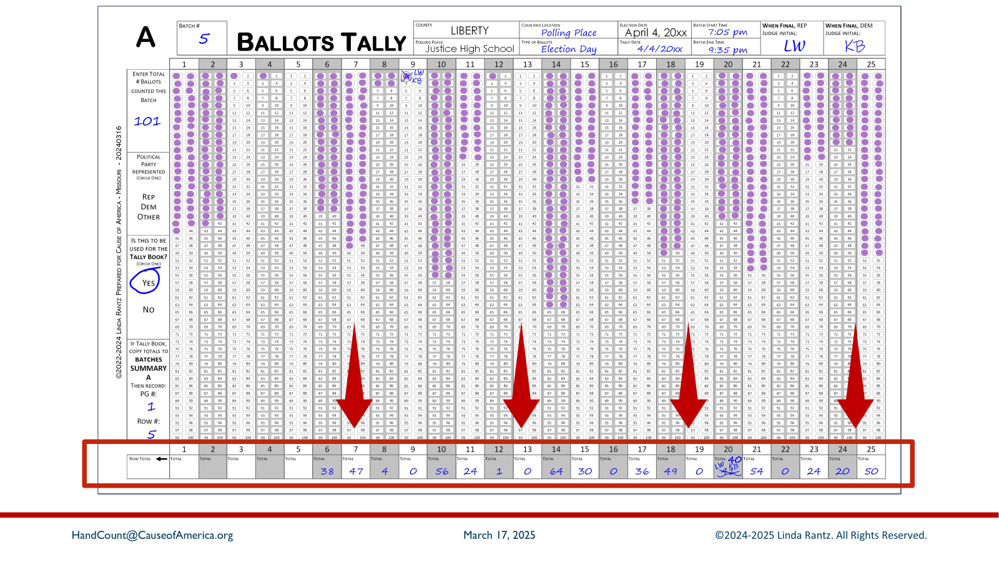
Notes:
When a “batch” is finished (explained in the next section), or all ballots have been counted, the total votes cast for each candidate are written in the bottom row (in blue ballpoint). For example, look at column 14: the next blank oval is #65. That means the preceding 64 ovals were “dabbed,” so this candidate received 64 votes. “64” is written in the bottom “totals” row in column 18.

Slide 26
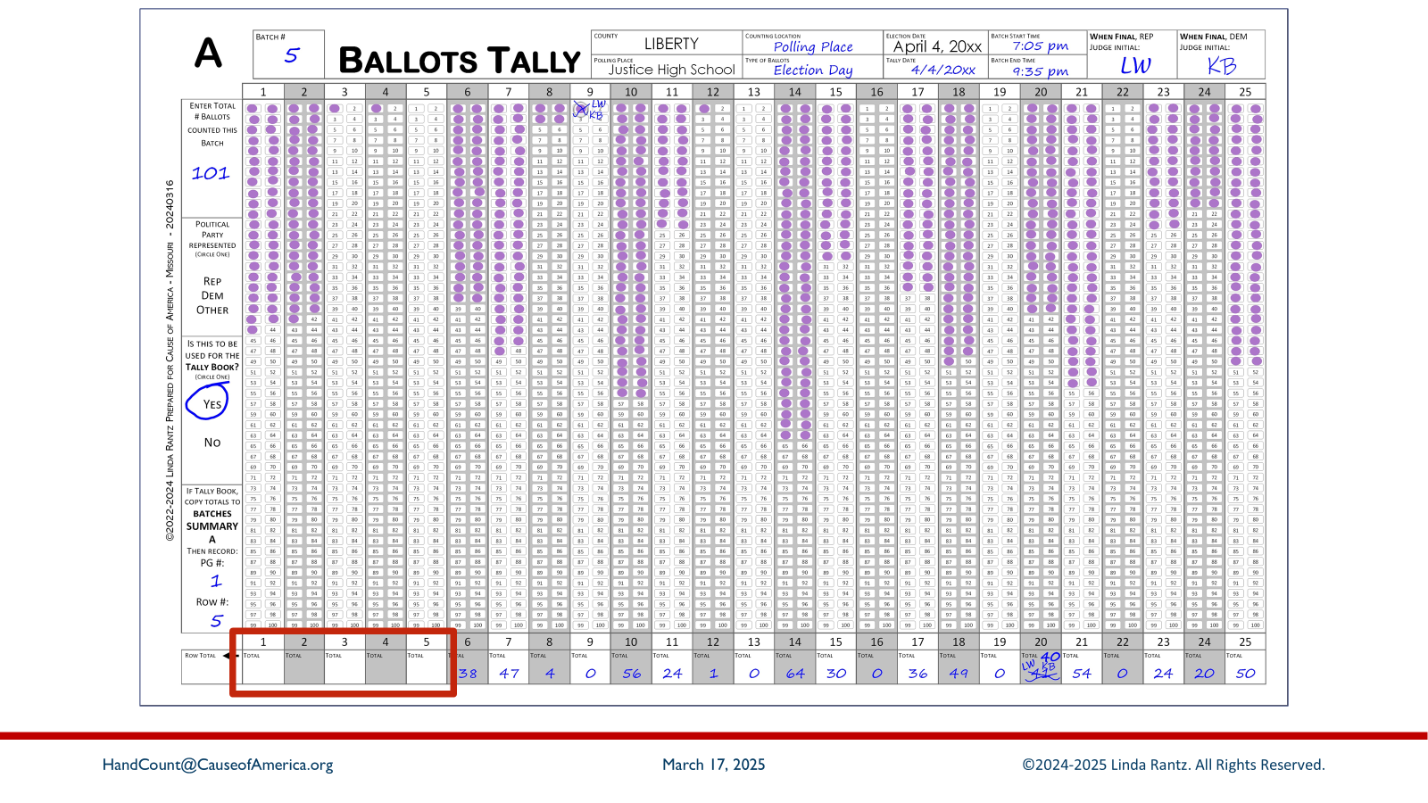
Notes:
The totals for columns 1-5 are blank because we will do some dabbing practice and add some votes to these columns. Use a Sharpie-style marker, if available. If not, use whatever writing instrument is available.
By the way – SHARPIES BLEED THROUGH, so be sure another piece of paper is under the Ballots Tally Form so little Sharpie-dab-marks don’t bleed through onto the table.

Slide 27
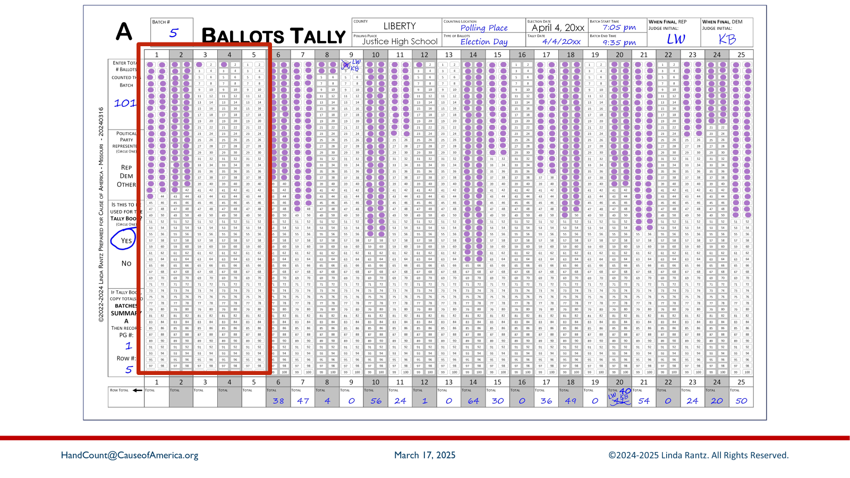
Notes:
There will only be votes called for the US Senator race, columns 1-5, so focus attention on the first five columns. As a vote is called, it will start with the column number – listen carefully for that number and go to the correct column. The candidate’s name and “senator” will also be called, but it is the number which is important.
For each vote called, the slide show will add a green dab to the correct candidate’s column. The pace of votes called will begin a little slower but pick up speed after the first few.

Slide 28
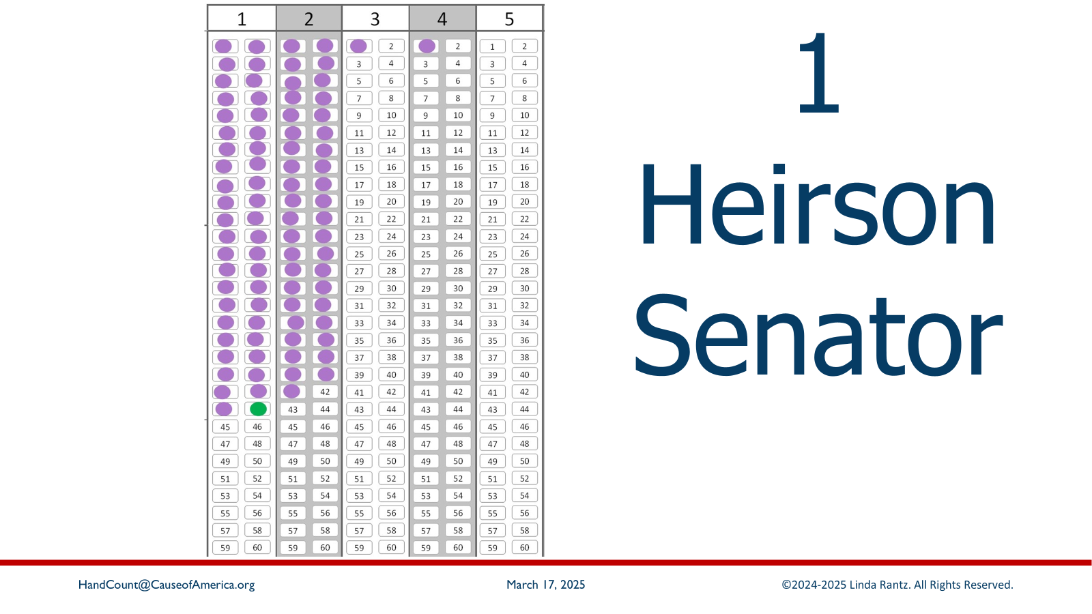
Notes:
1 – Heirson – senator (Ballot 1)

Slide 29
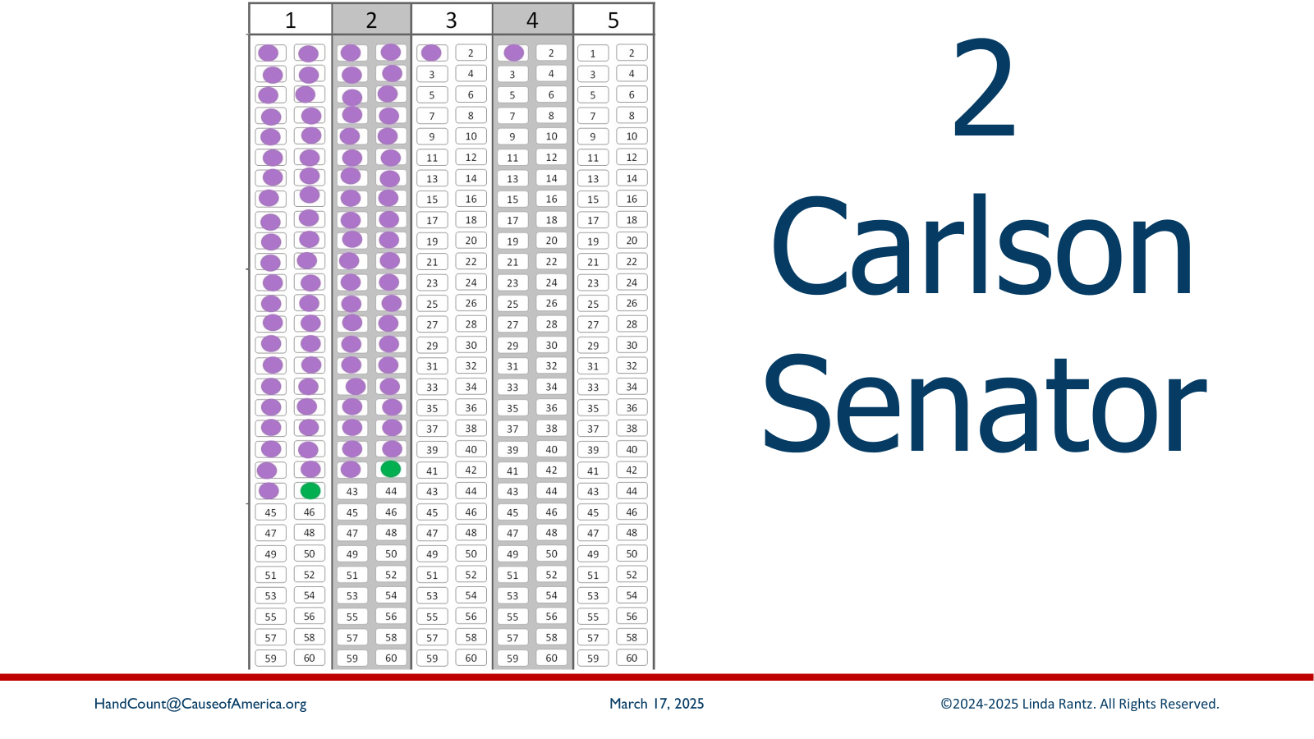
Notes:
2 – Carlson – senator (Ballot 2)

Slide 30
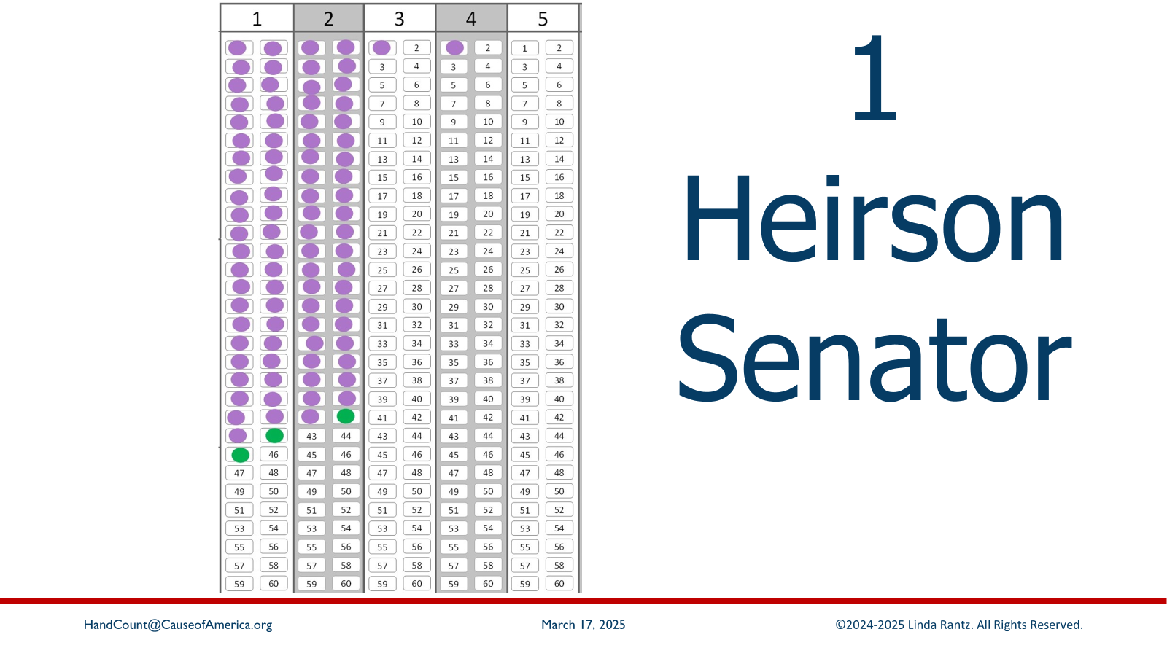
Notes:
1 – Heirson – senator (Ballot 3)

Slide 31
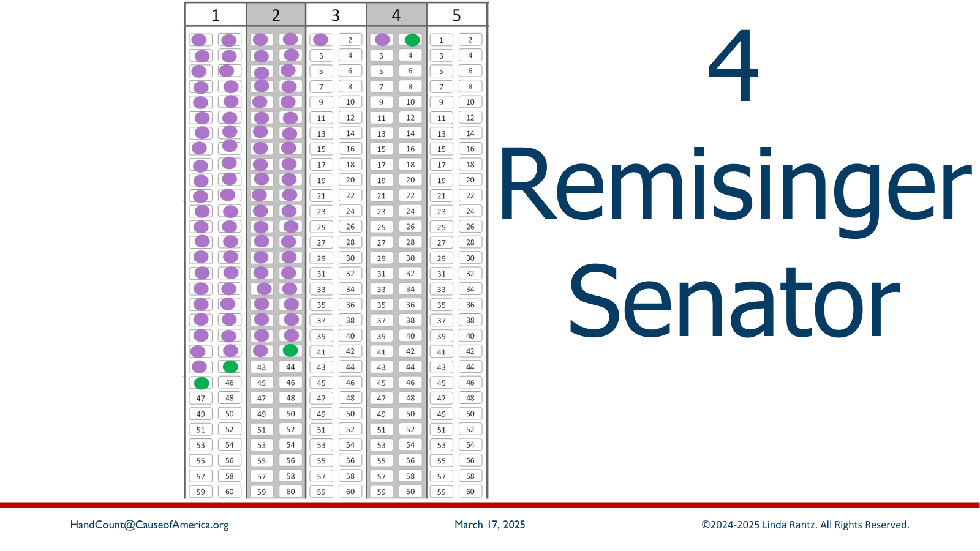
Notes:
4 – Remisinger – senator (Ballot 4)

Slide 32
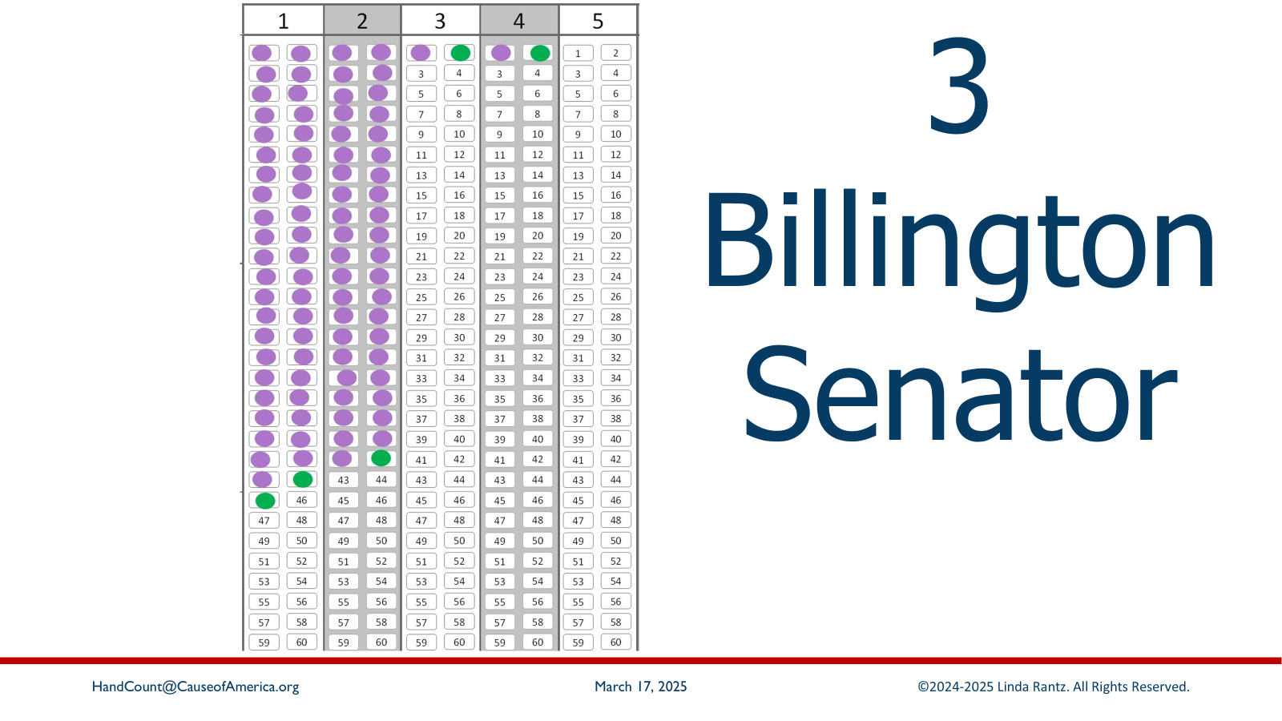
Notes:
3 – Billington – senator (Ballot 5)

Slide 33
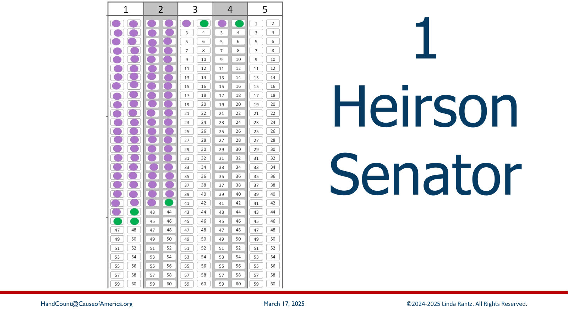
Notes:
1 – Heirson – senator (Ballot 6)

Slide 34
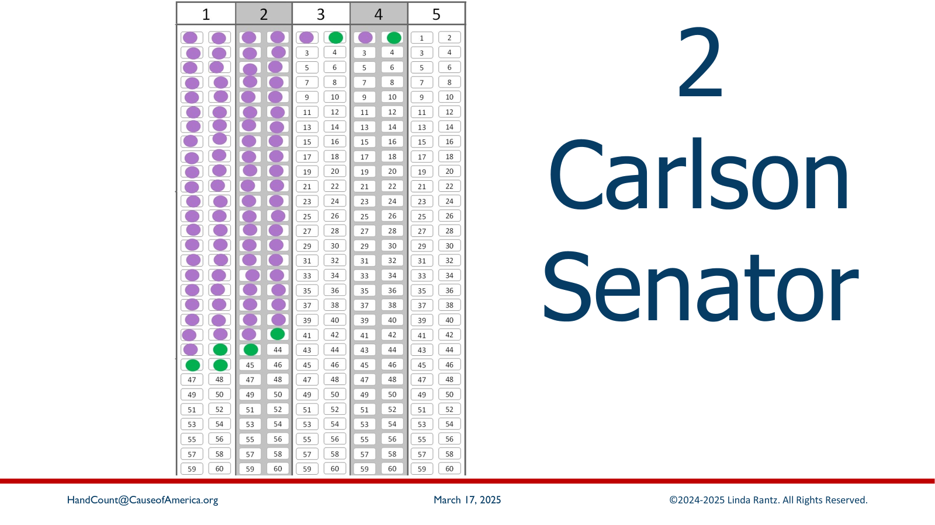
Notes:
2 – Carlson – senator (Ballot 7)

Slide 35

Notes:
1 – Heirson – senator (Ballot 8)

Slide 36
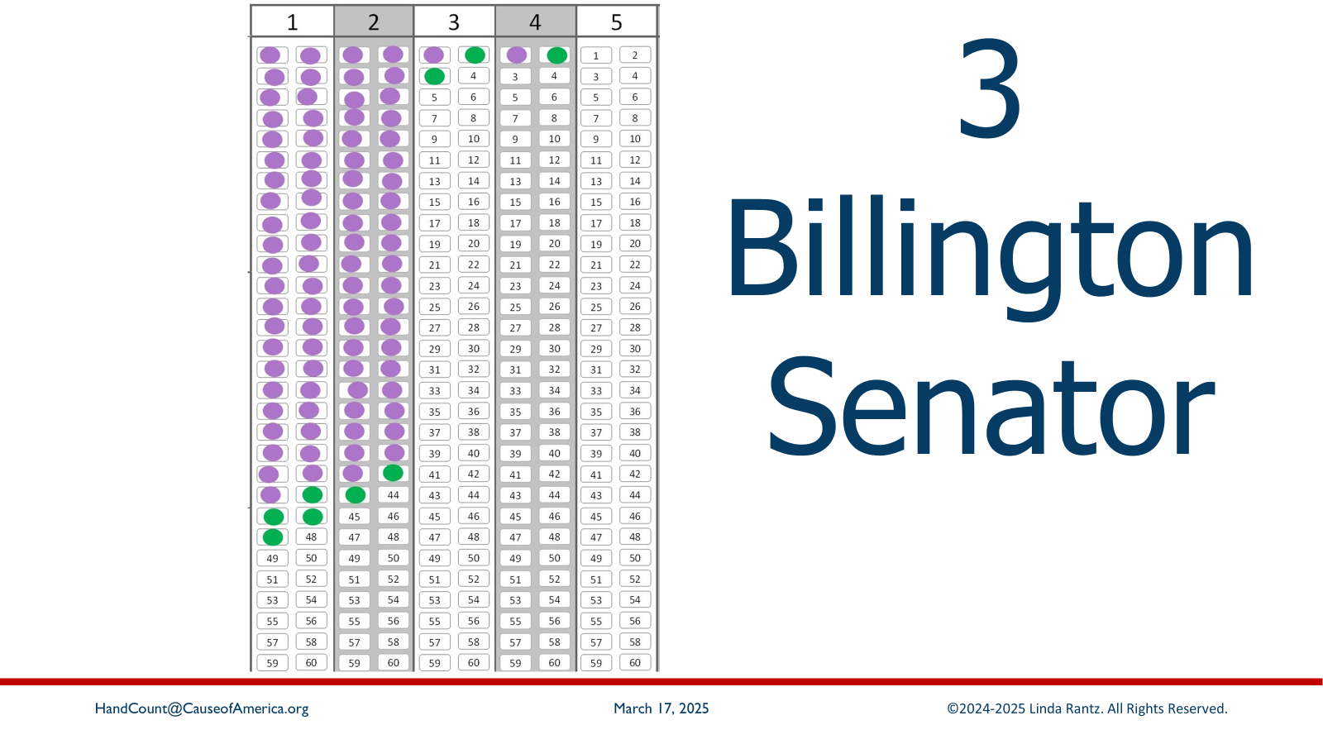
Notes:
3 – Billington – senator (Ballot 9)

Slide 37

Notes:
3 – Billington – senator (Ballot 10)

Slide 38
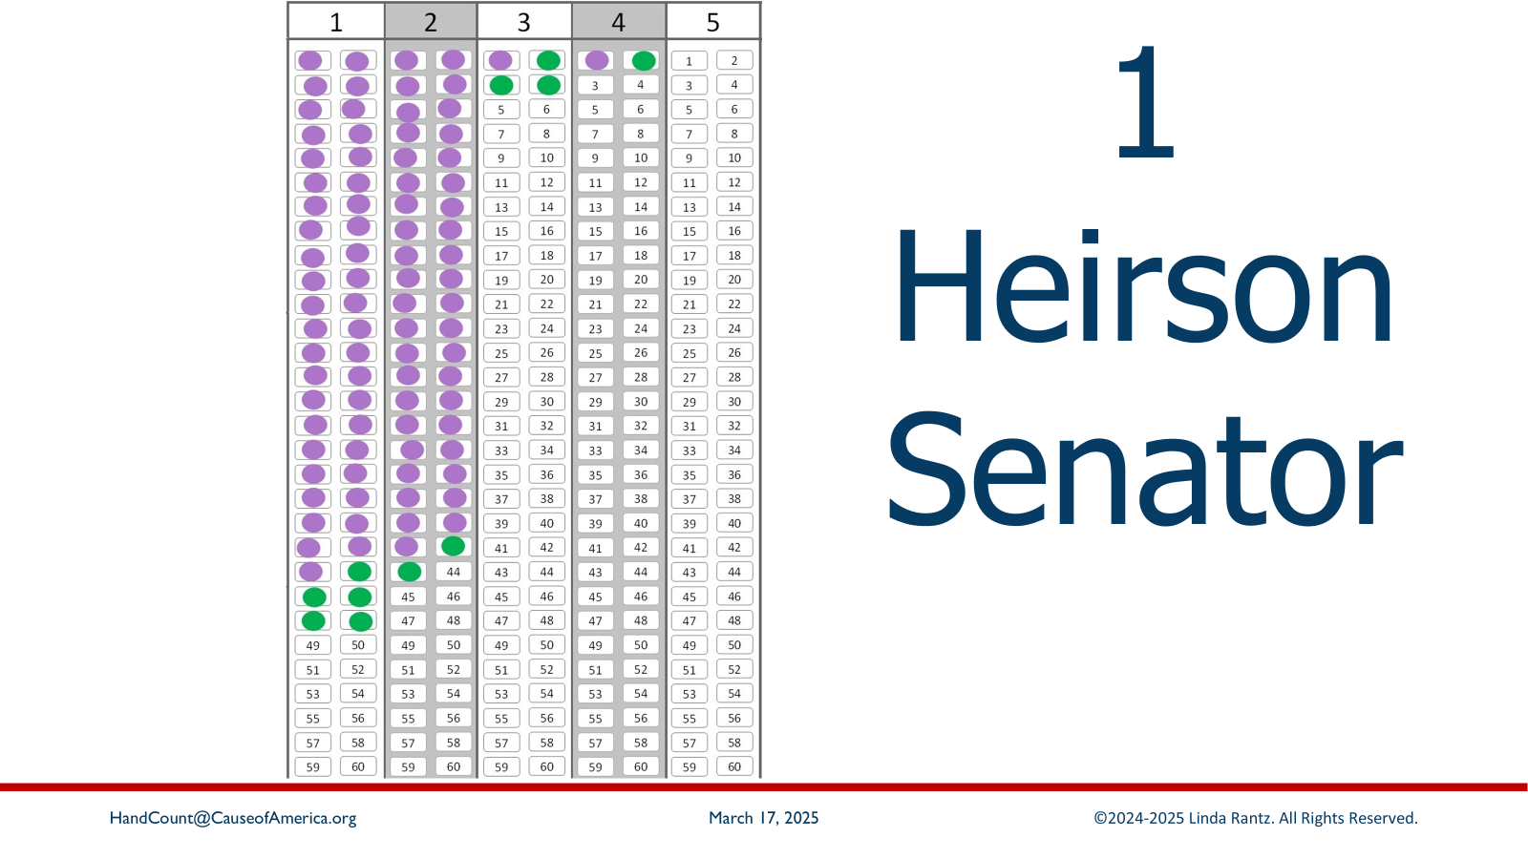
Notes:
1 – Heirson – senator (Ballot 11)

Slide 39

Notes:
4 – Remisinger – senator (Ballot 12)

Slide 40

Notes:
1 – Heirson – senator (Ballot 13)

Slide 41
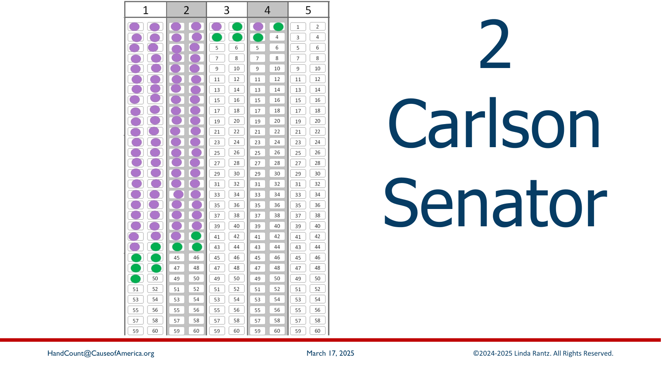
Notes:
2 – Carlson – senator (Ballot 14)

Slide 42
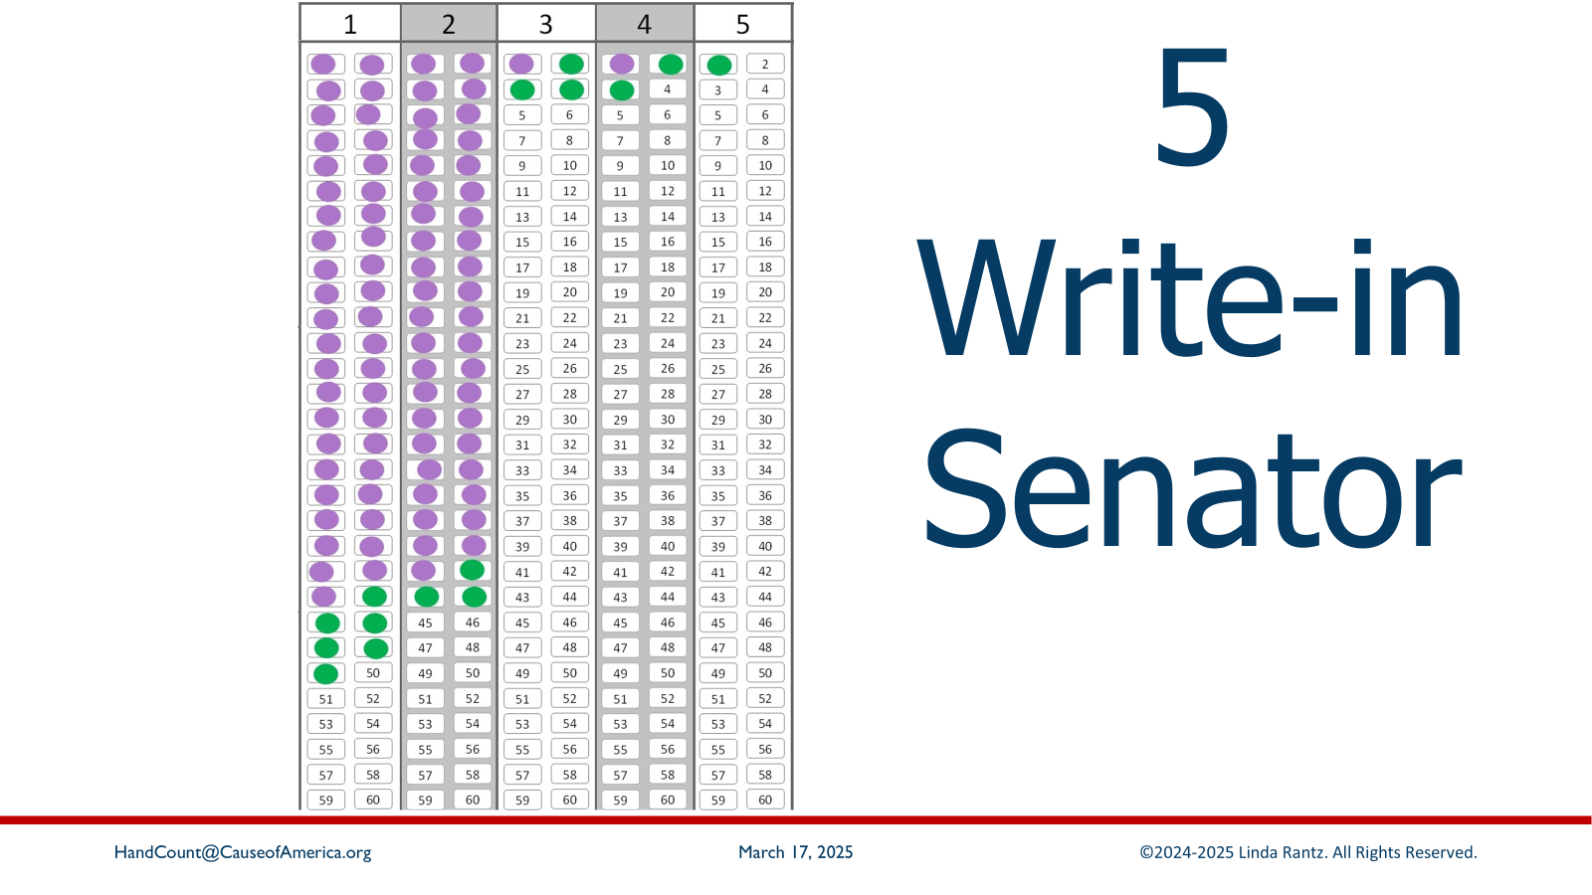
Notes:
5 – Write in – senator (Ballot 15)

Slide 43
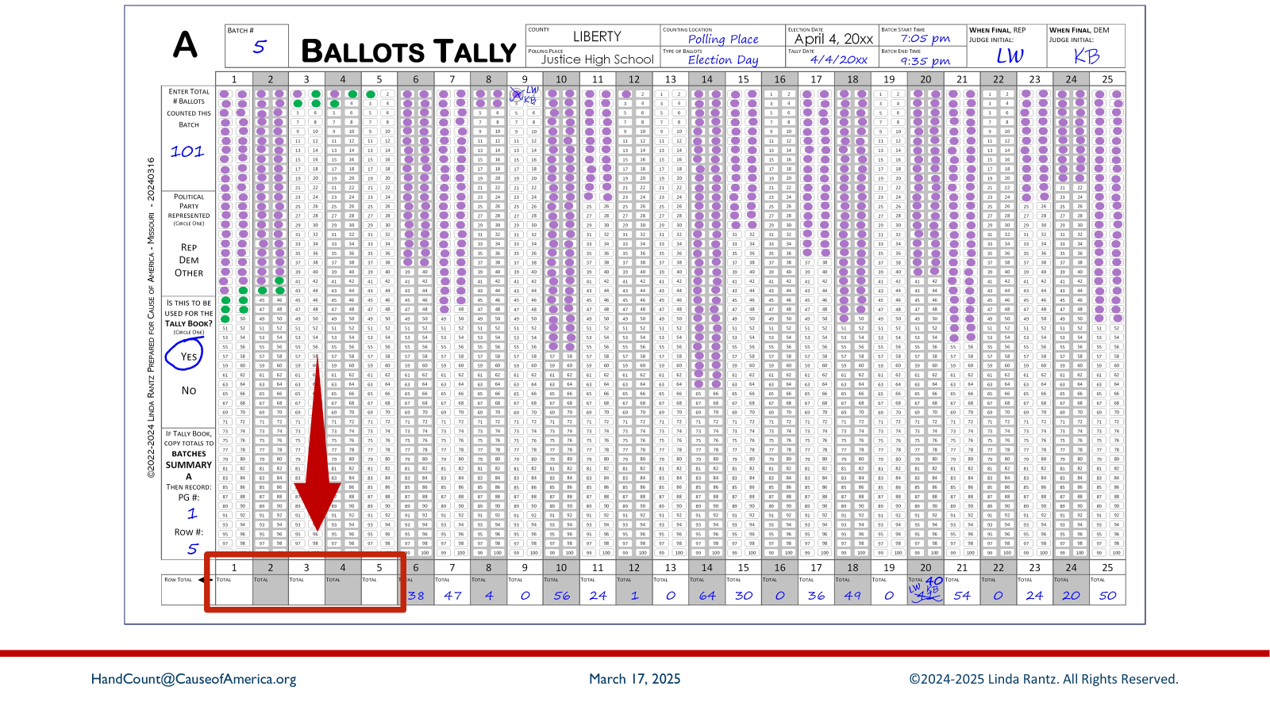
Notes:
That was 15 ballots/votes added to the ballots tally sheet. Of course, it is only done this way for training … votes would never be added like this for an actual election.
Now the totals need to be brought down to the Totals Row. Look at the last oval that is dabbed in each column. The number preceding that oval is how many votes were cast.

Slide 44
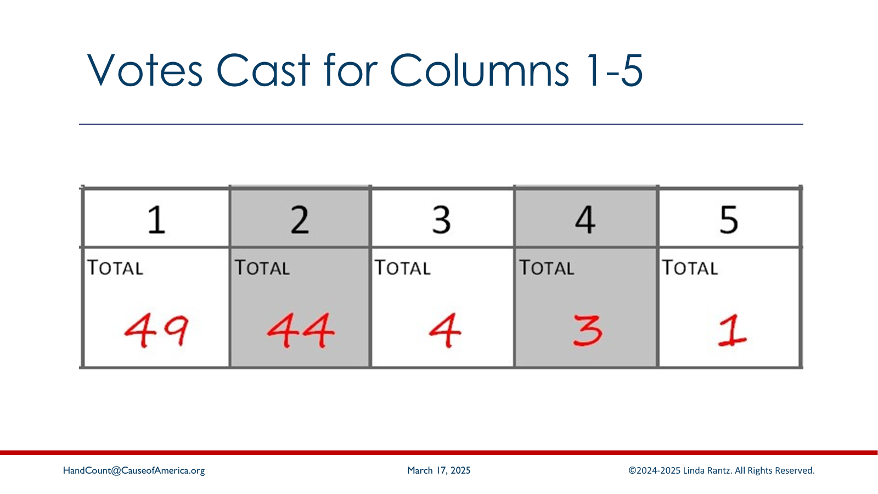
Notes:
Here are the correct totals for columns 1 through 5.

Slide 45
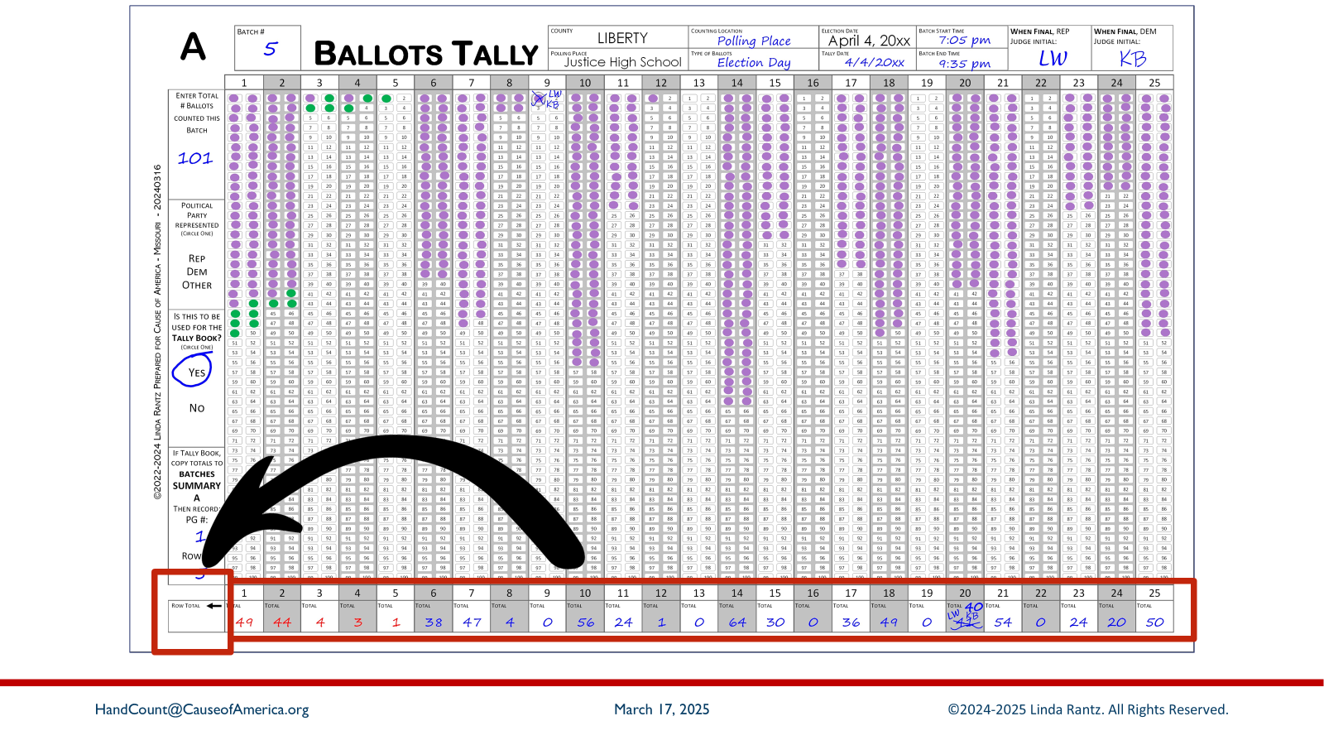
Notes:
The leftmost box on the bottom Totals Row is a box to record the total votes cast from columns 1-25. In an election, the judges will add the 25 columns to get the grand total.

Slide 46
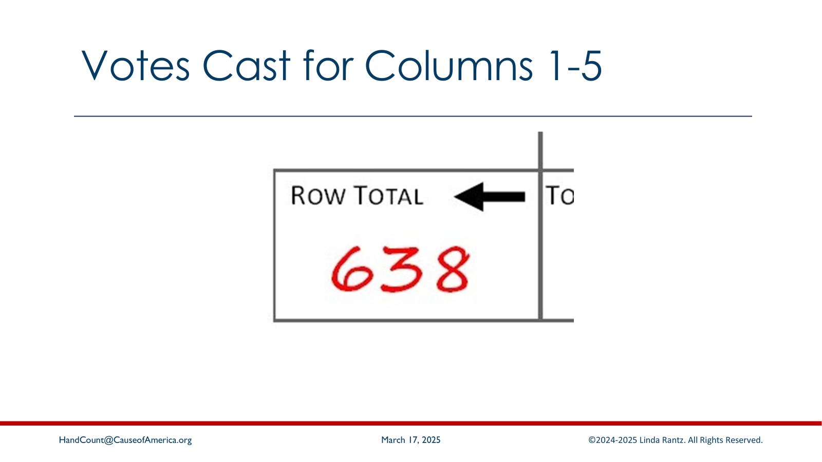
Notes:
The total of the bottom row is 638. That represents the number of votes counted. Keep in mind, a ballot is the piece of paper; each mark on the paper is a vote.

Slide 47
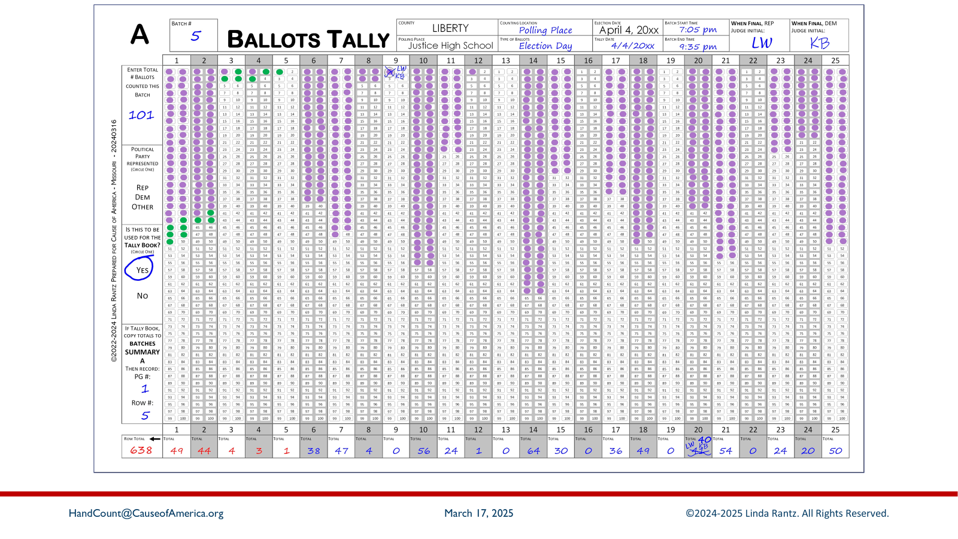
Notes:
At this point, the Republican and Democrat Recording Judges “overlay” their ballots tally forms and compare the totals and reconcile any discrepancies.
Before we go to the next section, look at some of the other information on this form.

Slide 48
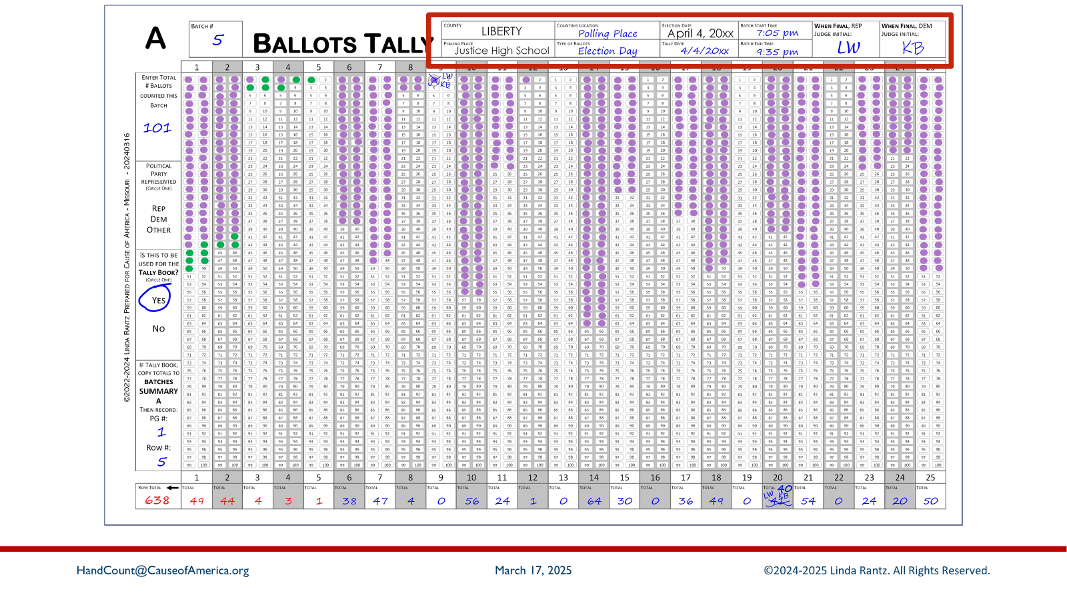
Notes:
The top header has information about the polling place, election, and counting details. Notice the judges initialed the front of the form. In an actual election, there is also a certification form on the back signed by the judges.

Slide 49
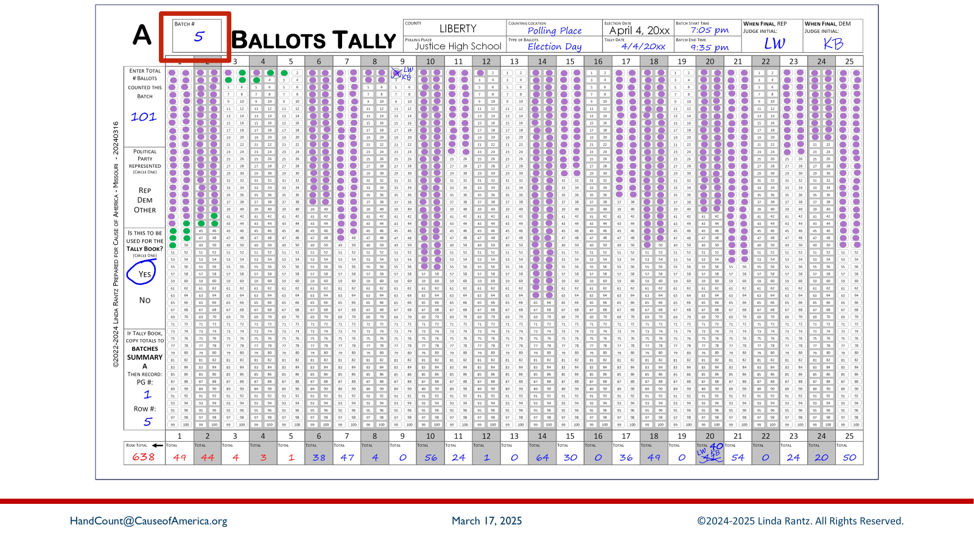
Notes:
At the top left, the batch number is recorded. This is batch #5, which means this polling place has already had 4 other batches of ballots counted. What determines a batch? When all the ballots in the ballot box have been counted, or if any column on the Ballots Tally form gets to 100 votes cast.

Slide 50
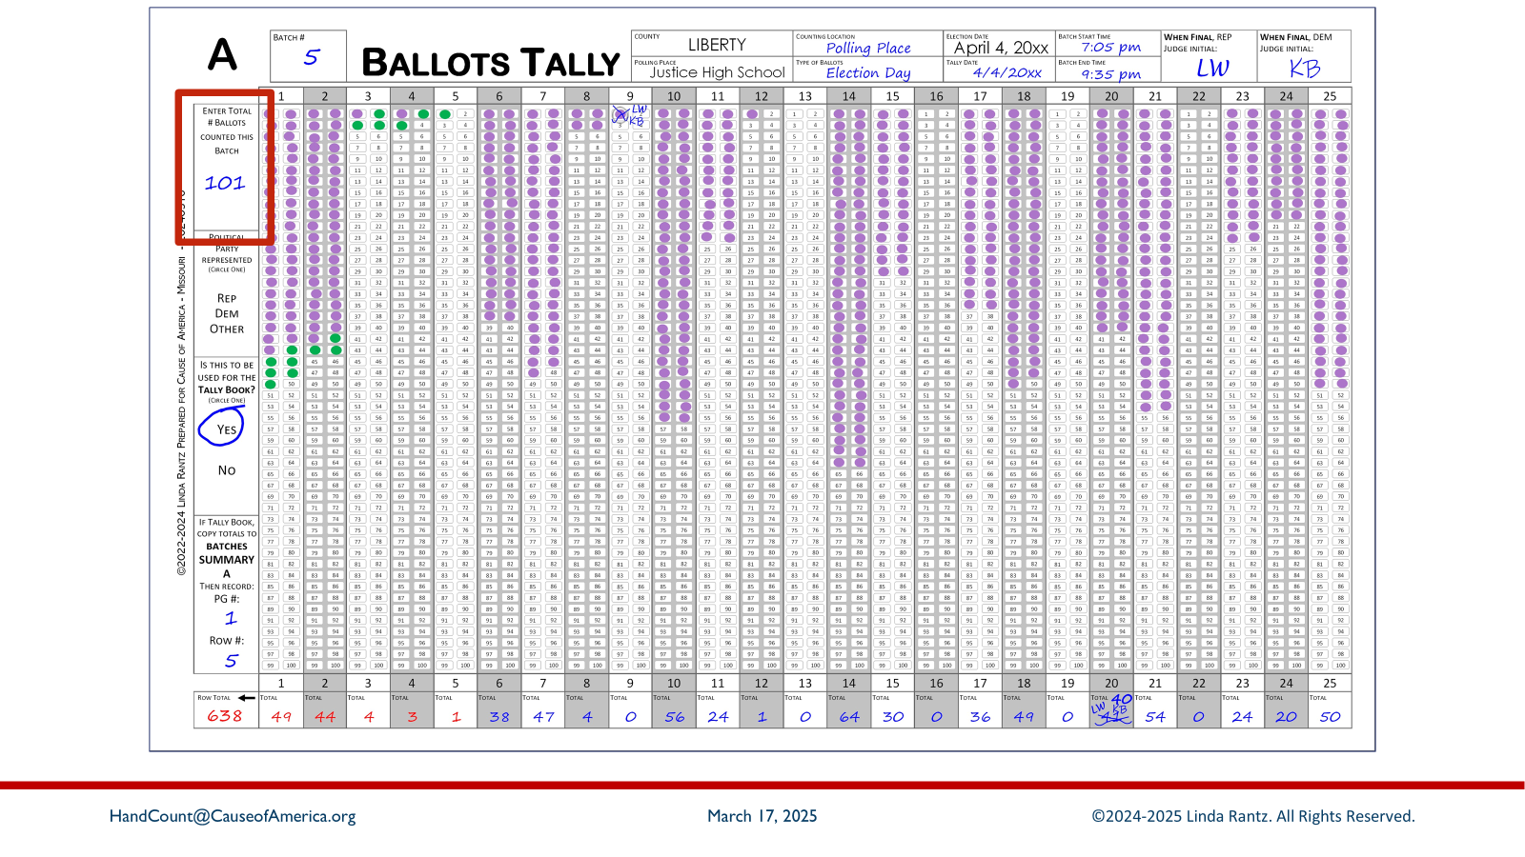
Notes:
The left sidebar records how many ballots (pieces of paper) were counted for this batch. In this example, 101 ballots were counted in this batch.

Slide 51
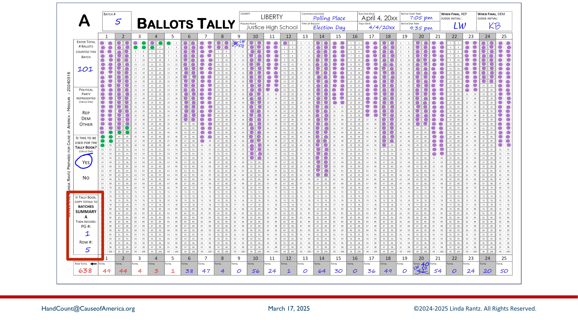
Notes:
The bottom box on the left sidebar refers to “Batches Summary A” sheet. That is the next form, and this box directs where the totals from this form were recorded, so keep this in mind.

Slide 52

Notes:
Attendees should take out the Batches Summary sheet from their handouts. Both the Ballots Tally form and the Batches Summary sheet are needed for this next section.

Slide 53
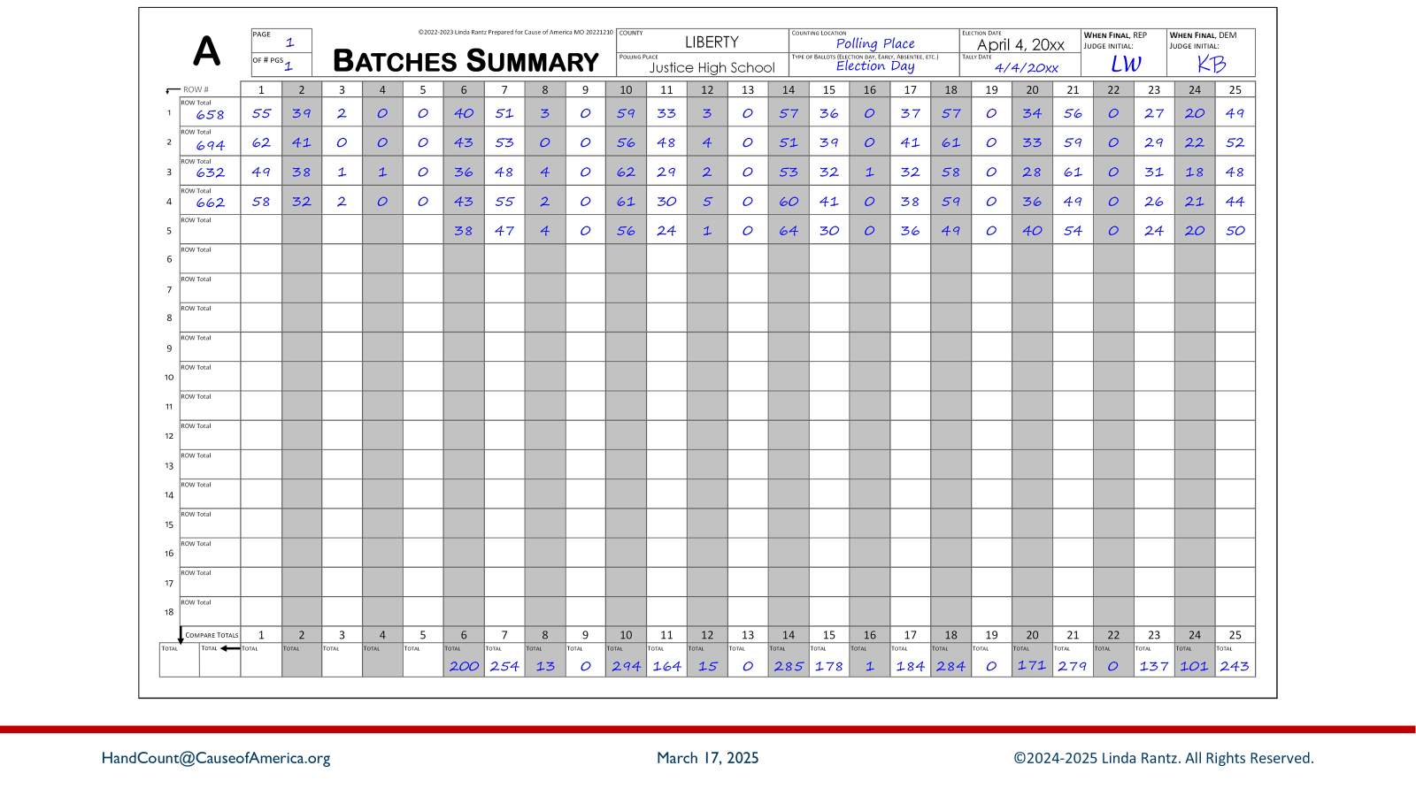
Notes:
This image matches the Batches Summary sheet handout given to attendees. The Batches Summary is exactly what the name implies: a summary of all the batches counted at the polling place for a specific Group. The form is similar in style to the Ballots Tally form to make it easier to transfer and compare information between forms.

Slide 54
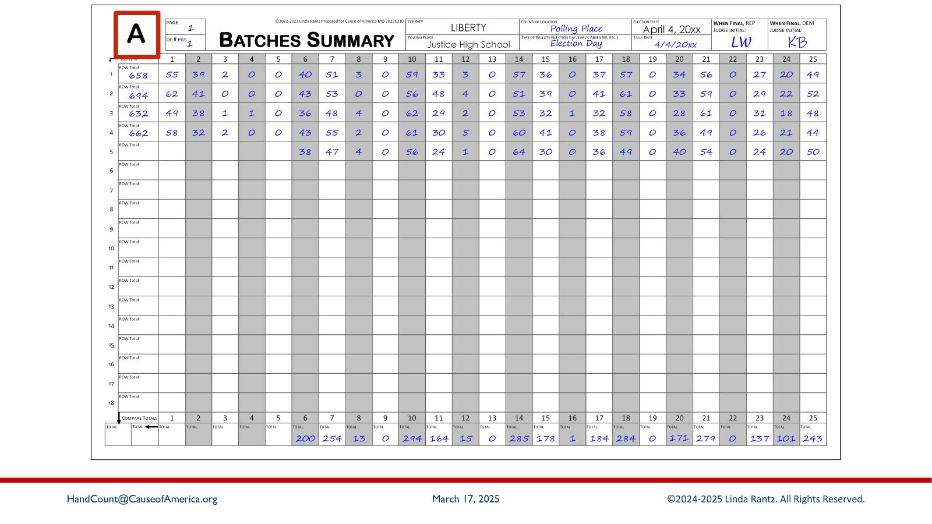
Notes:
This Batches Summary sheet is specific to Group A. There are Batches Summary forms for Group B and other groups in this mock election, but they are not included as part of Express Training.

Slide 55
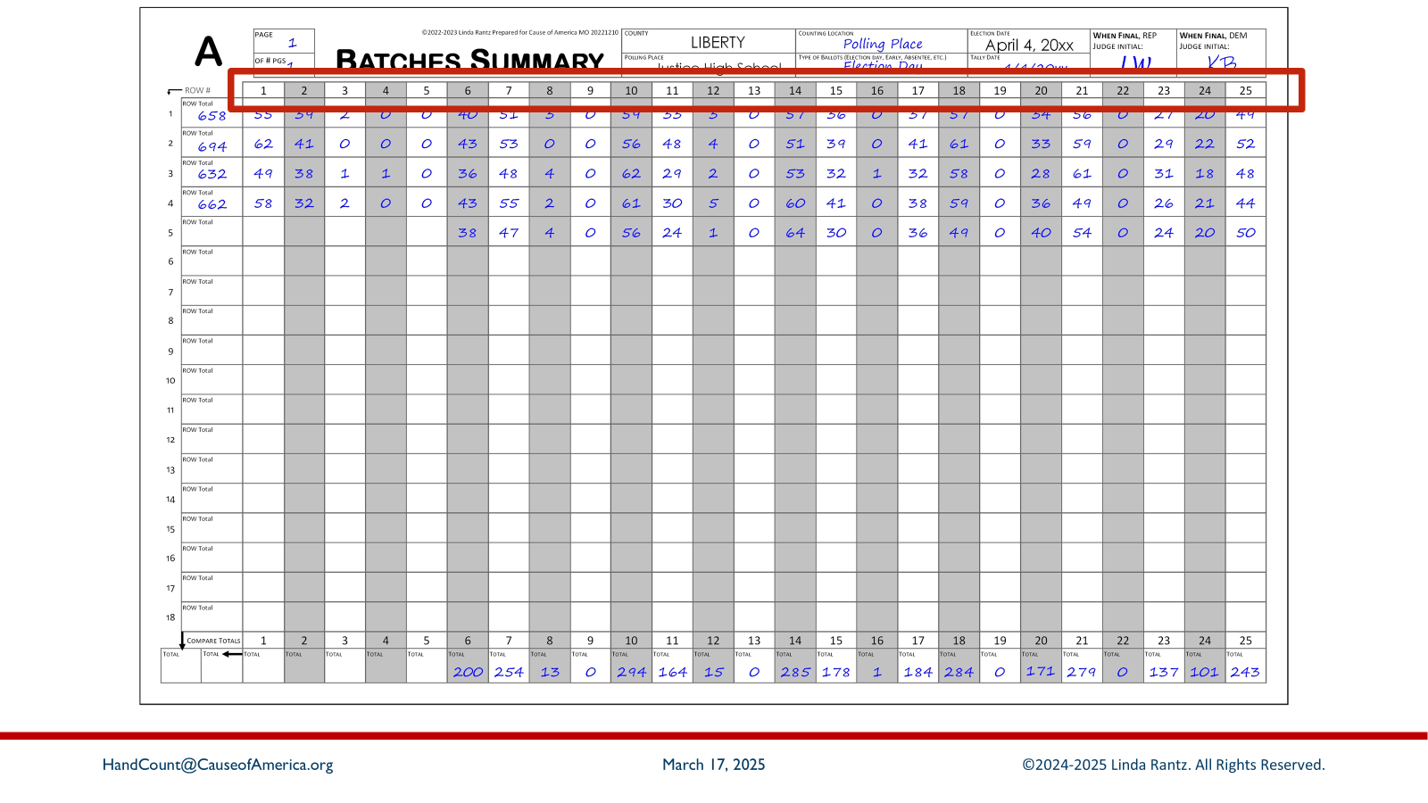
Notes:
The column header shows candidate numbers 1 through 25.

Slide 56
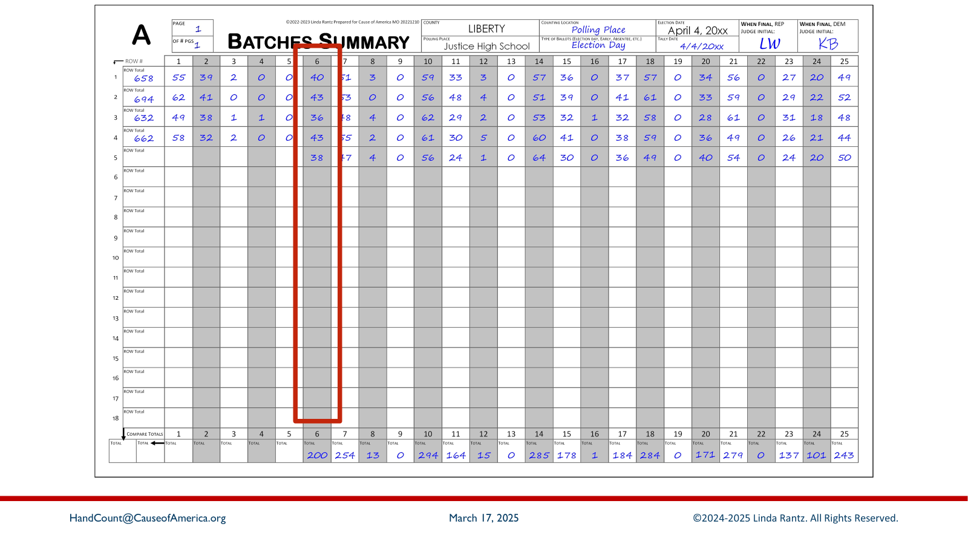
Notes:
Instead of vote tallies or dabs, the columns on the Batches Summary sheet shows the total votes counted for the candidate in each “batch.”

Slide 57
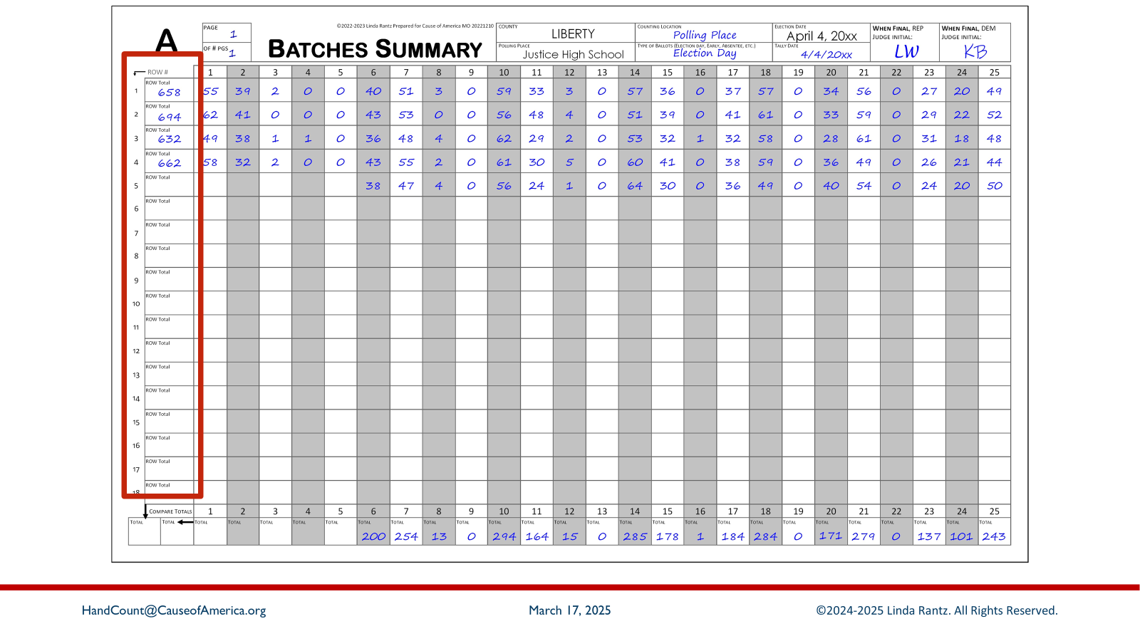
Notes:
The Row Totals from the Ballots Tally form were also transferred to this sheet.

Slide 58
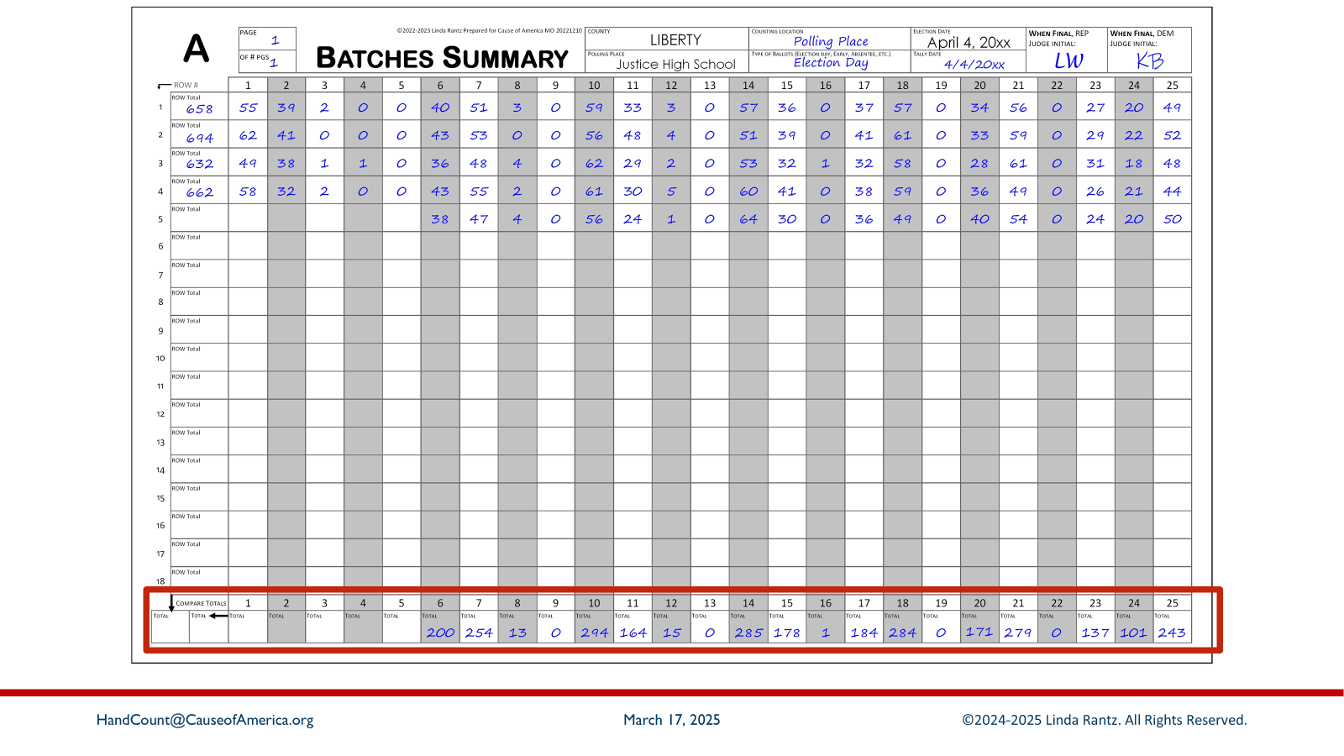
Notes:
And, when all batches are complete and there are no more ballots to count, each column will be added, and the total will be recorded in the bottom row.

Slide 59
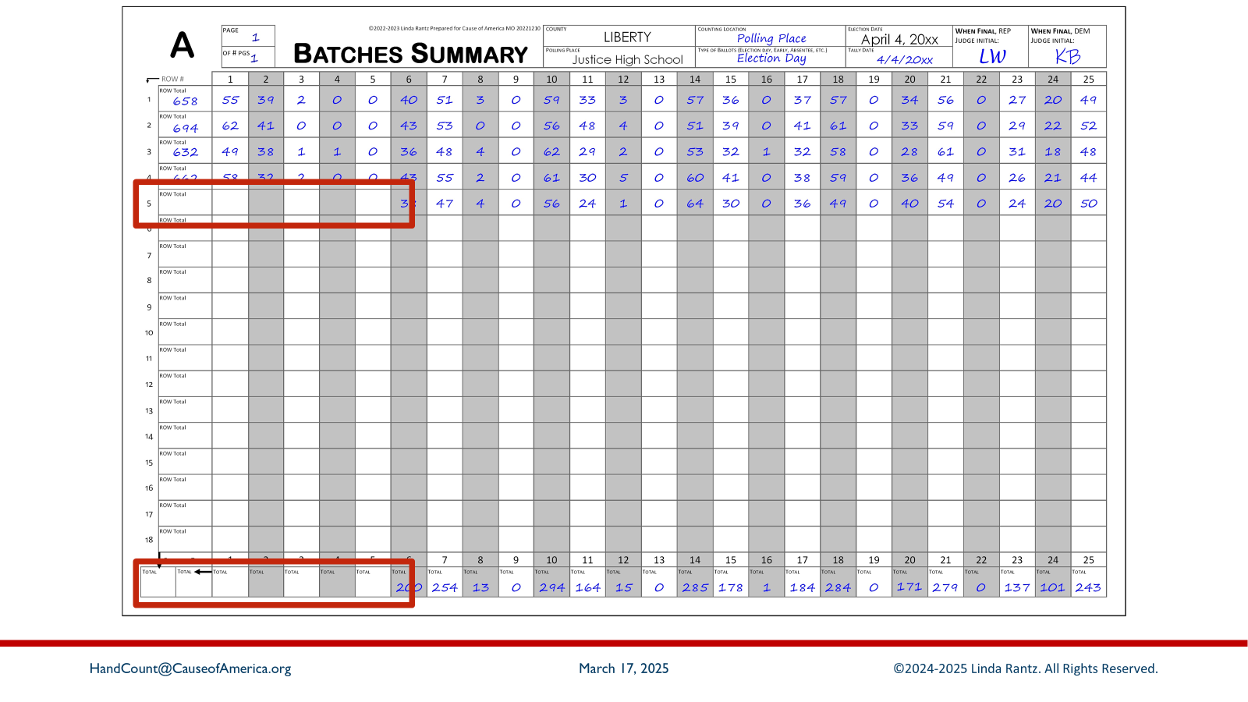
Notes:
Notice the information for the US Senator race, columns 1 through 5, has not been completed yet so it can be done as part of training.

Slide 60
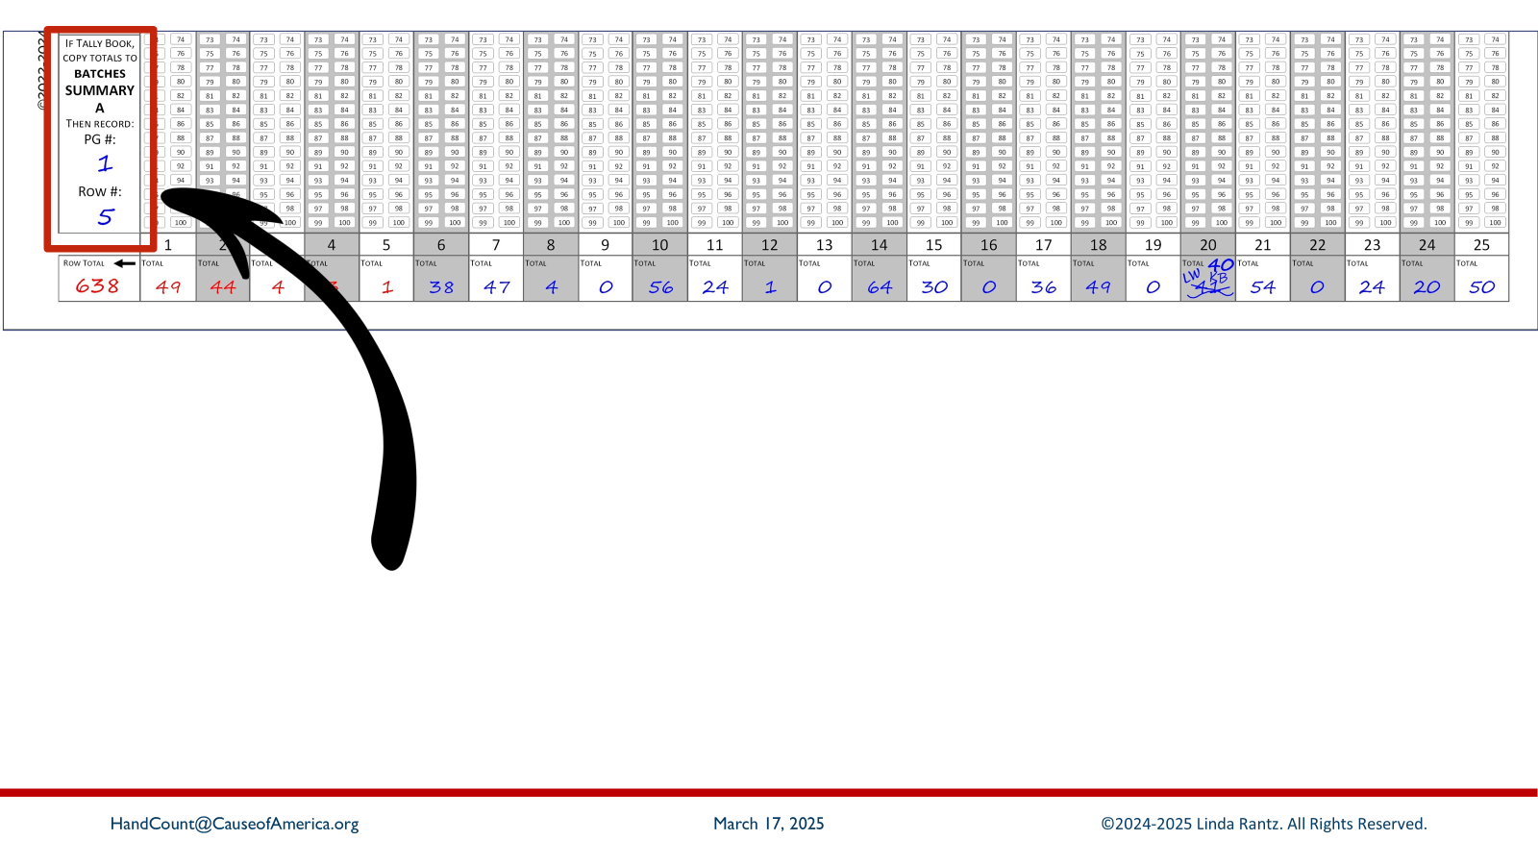
Notes:
Look back at the Ballots Tally form, the bottom box of the left sidebar.

Slide 61
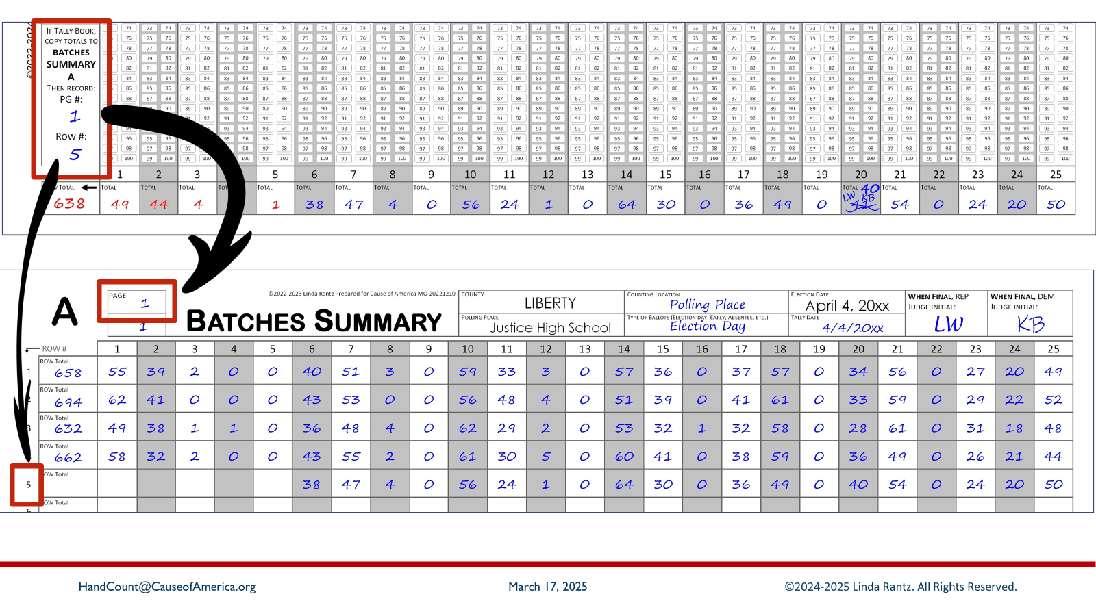
Notes:
It shows that the totals from the Ballots Tally form are recorded on page 1, row 5 of the Batches Summary sheet (bottom screenshot).

Slide 62
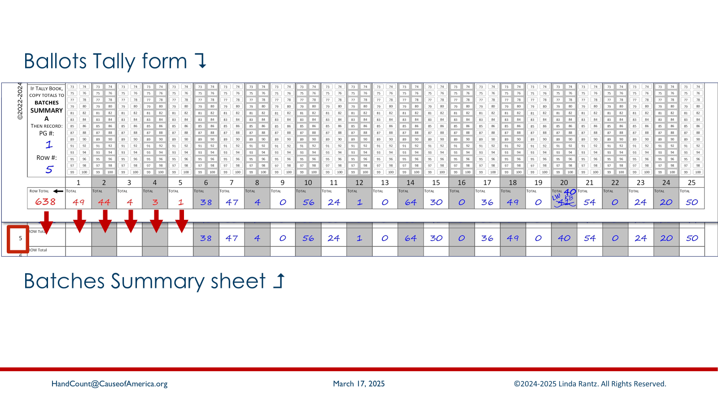
Notes:
Overlay the Ballots Tally form on top of the Batches Summary sheet, so that the bottom row of the tally form aligns with Row 5 of the batches sheet. Copy the totals from the tally form to the Batches Summary sheet.

Slide 63
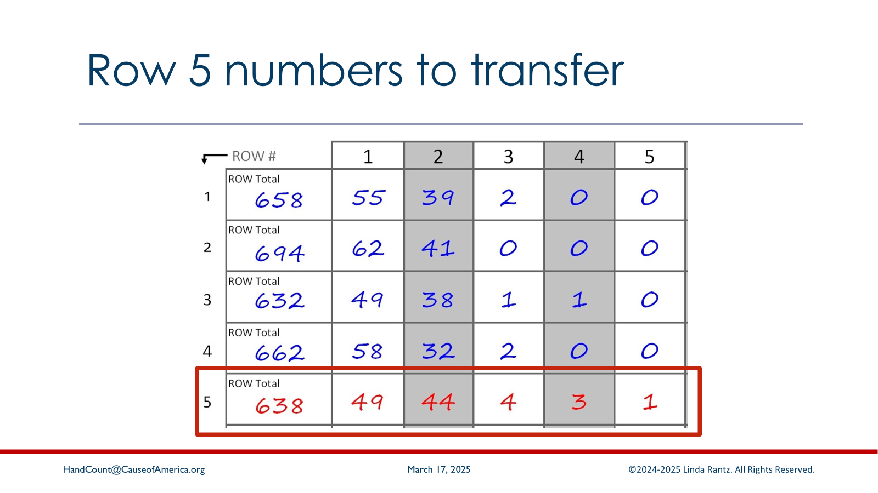
Notes:
These are the numbers that should be written in columns 1-5 on ROW 5 of the Batches Summary.

Slide 64
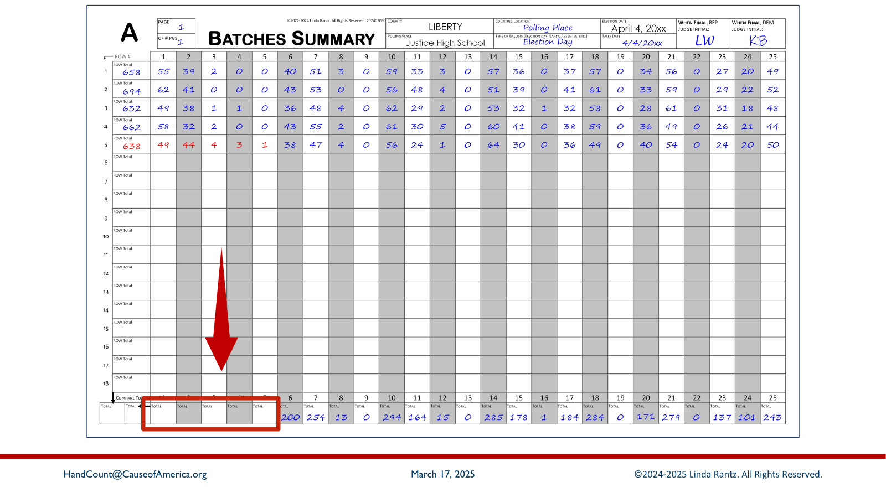
Notes:
Batch 5 is the final batch for this mock election, so the columns of the Batches Summary form are ready to be added and recorded in the bottom row. Notice that columns 6 to 25 have been completed. Now, columns 1 through 5 (with the numbers just recorded on row 5) need to be added and recorded in the bottom row.

Slide 65
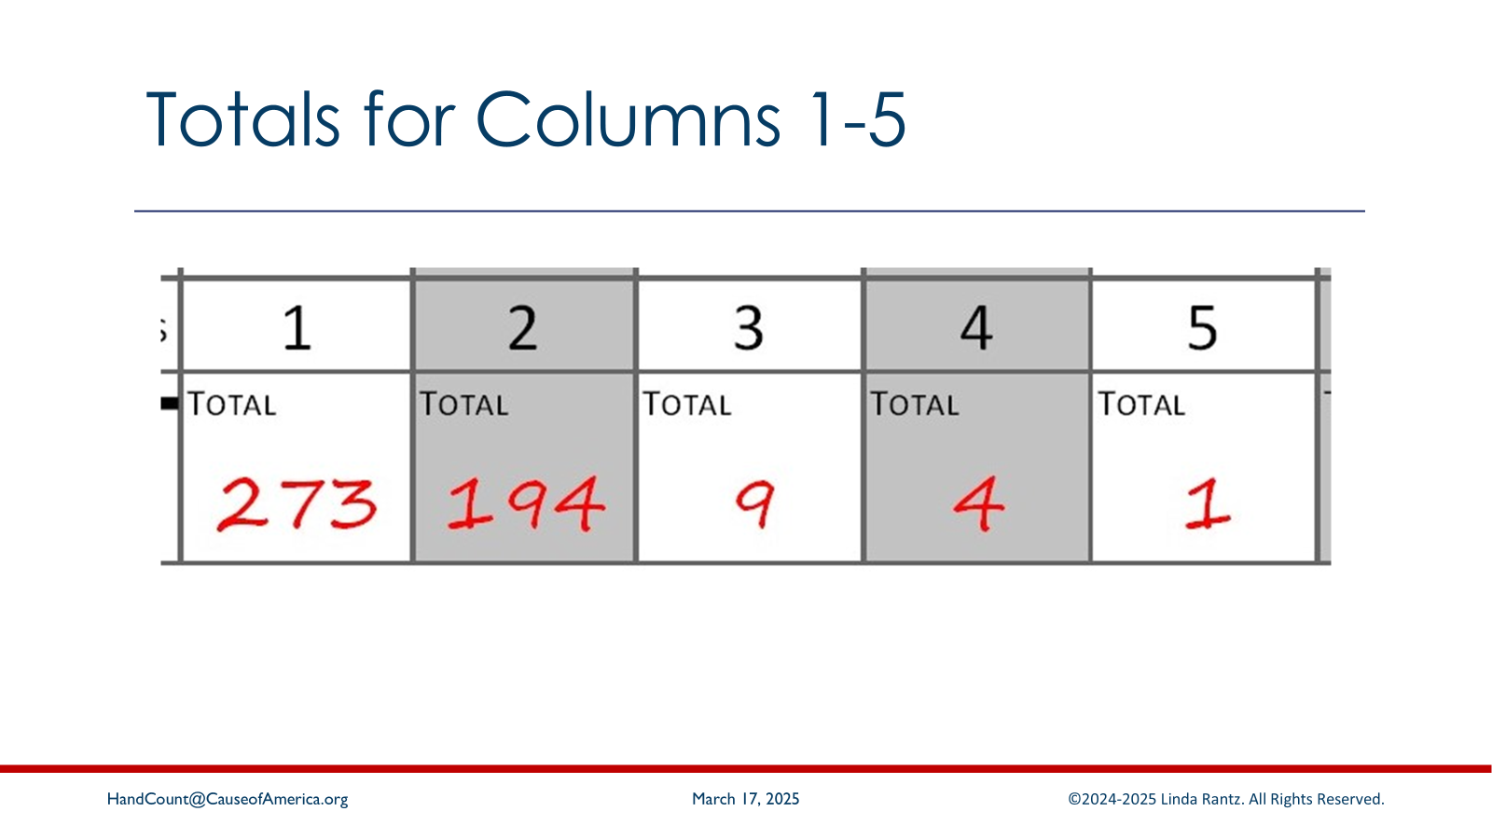
Notes:
These are the numbers that should be written in columns 1-5 on the TOTALs row of the Batches Summary.

Slide 66
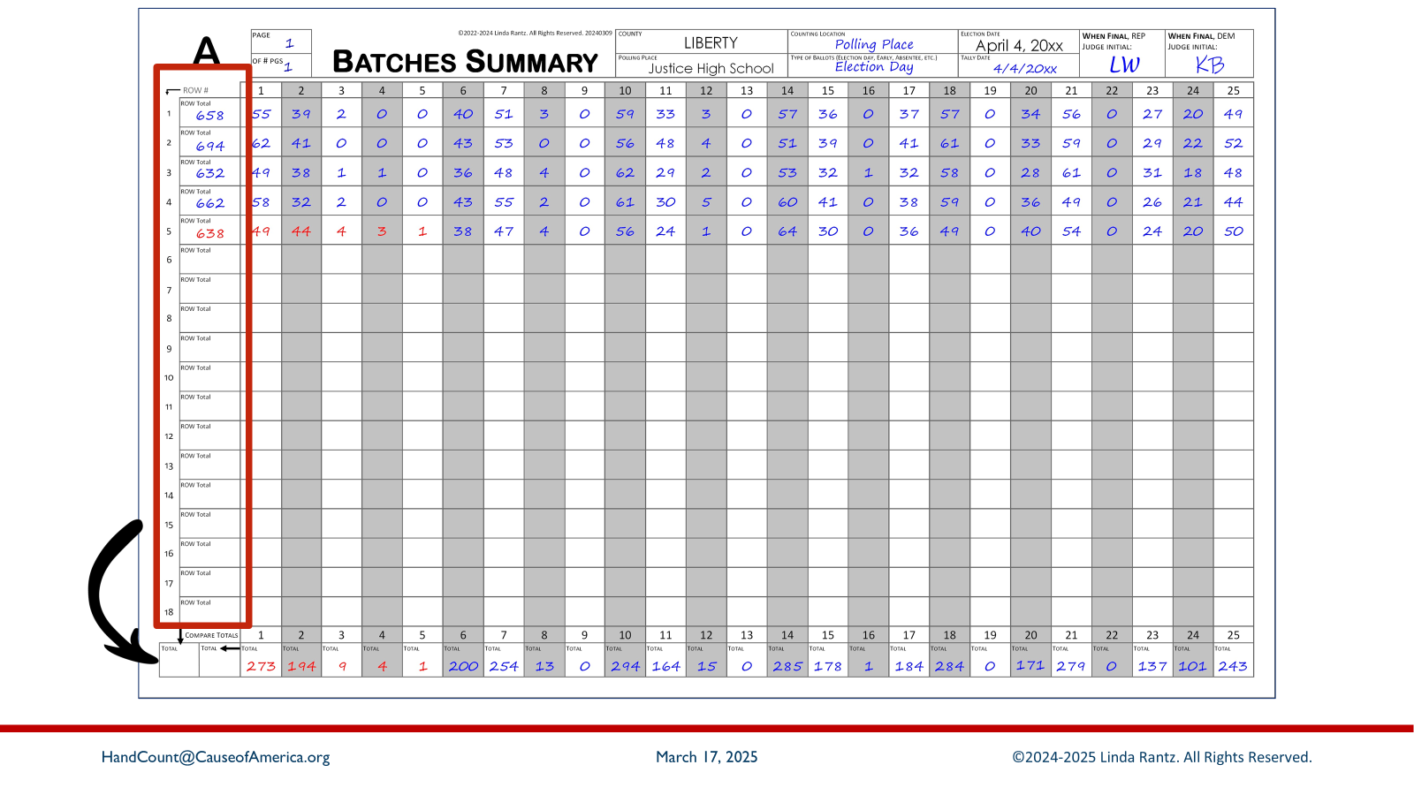
Notes:
The column that had the row totals also needs to be added and recorded in the bottom row (left box).

Slide 67
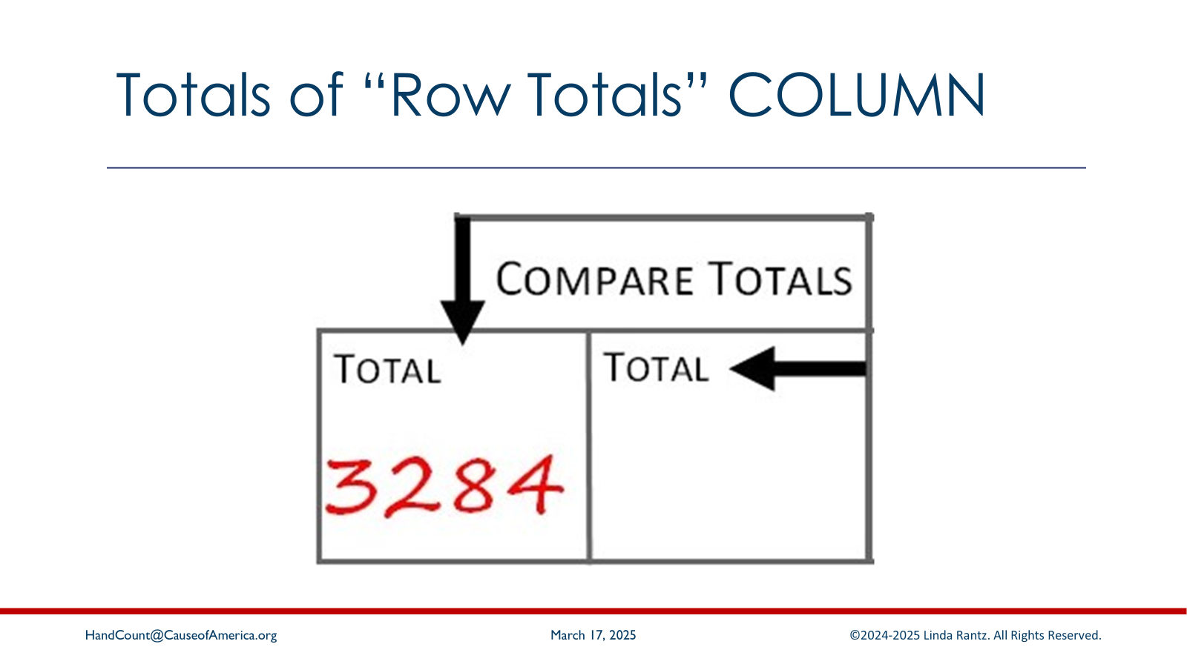
Notes:
The total of the left column (of row totals) is 3,284.

Slide 68
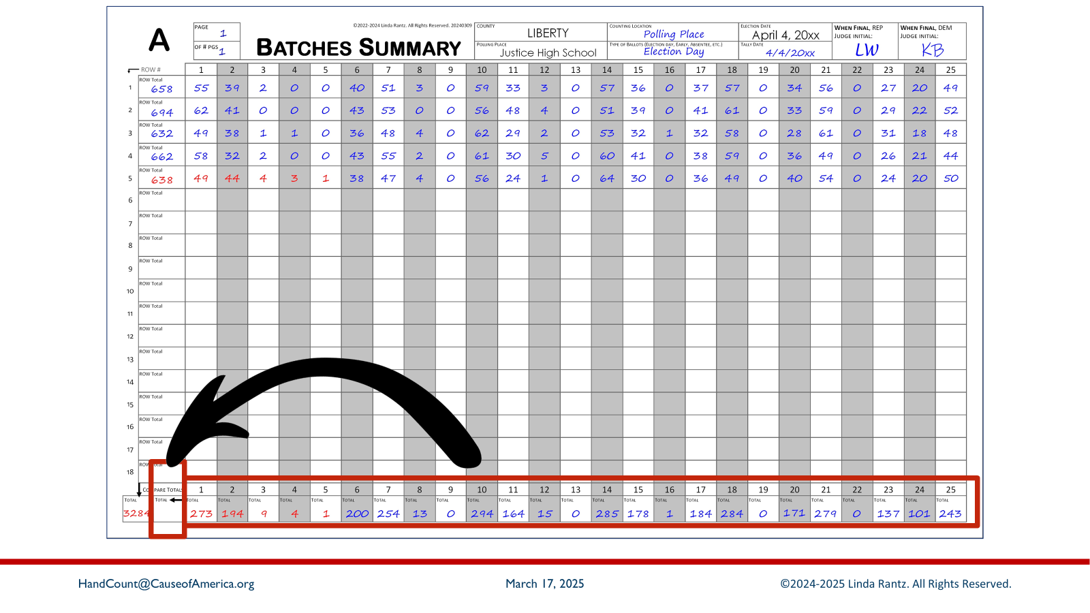
Notes:
To double-check the totals in the bottom row, add the totals for all 25 columns and enter in the box just to the left of column 1 in the bottom row.

Slide 69

Notes:
The total of the bottom row 3,284. This matches the column total. If they didn’t match, there is either a math or tally error. The judges will need to locate the issue before proceeding.

Slide 70

Notes:
The Batches Summary for Group A is now complete. The judges initial on the top header and will sign the certification on the back of the form. The Batches Summary for other Groups (such as B and Q.A) are also completed. When all the Batches Summary sheets have been signed, the final results of the election can be recorded.

Slide 71

Notes:
Attendees should take the Results of Polling Place document from their handouts. They will still need the Batches Summary sheet, but the Ballots Tally form may be set aside.

Slide 72

Notes:
This image matches the handout the attendees received. Notice that the Results of Polling Place document resembles the two previous forms in appearance, and with rows containing 25 columns.

Slide 73

Notes:
Each row represents vote totals from the corresponding Batches Summary sheet. The “group” ID’s are on the very left of the form.

Slide 74

Notes:
The next column to the right indicates how many Batches Summary sheets were completed for each Group. A single Batches Summary sheet can handle 18 batches. If there were more batches than 18, additional sheets would need to be used. Notice that there is one sheet indicated for Group B and one for Group Q.A (and those totals have already been transferred).

Slide 75

Notes:
The Batches Summary sheet for Group A shows “page 1 of 1” at the top, indicating that only ONE sheet was needed to complete the ballot counting. Enter “1” in the “# Summary Sheets” box on the row for Group A on the Results of Polling Place document.

Slide 76

Notes:
The totals from Batches Summary Group A are recorded in the top row of the Results document (see “Group A” on the left side of the row), except for columns 1 through 5.

Slide 77

Notes:
Transfer the vote totals from columns 1-5 of Batches Summary Sheet – Group A, to the top row of the Results of Polling Place document which shows it is for Group A totals.

Slide 78

Notes:
These are the numbers that should be written in columns 1-5 on the TOTALs row of the Results of Polling Place.

Slide 79

Notes:
The Results of Polling Place is complete and, basically, are the results of votes cast in the polling place. The judges would initial in the top header and sign the certification that would be printed on the back of the documents.

Slide 80

Notes:
Attendees should take the Statement of Returns document from their handouts. They will still need the Results of Polling Place document, but the Batches Summary sheet may be set aside.

Slide 81

Notes:
The Statement of Returns for Polling Place lists the final vote count from the polling place for each candidate. Notice the first 5 rows are for the US Senator race. The “Votes Cast” column for these 5 candidates are blank (other races have been completed). The final votes cast for these 5 candidates will be transferred from the Results of Polling Place.

Slide 82

Notes:
From Column #1, on row Group A of the Results of Polling Place, copy the votes cast total to ROW 1 of the Statement of Returns for Polling Place. Repeat for rows 2 through 5.

Slide 83

Notes:
These are the vote totals that should be written in rows 1-5 on the Statement of Returns.

Slide 84

Notes:
This mock election, even though the focus was on candidates, also had “questions” on the ballot. The process for counting and reporting votes cast for questions is the same, although they are recorded on a Statement of Returns specifically for Questions. When all tallying, reconciling, and forms are complete, the judges will sign the certification stating that the numbers being reported represent the votes cast in the polling place.

Slide 85

Notes:
In an election, two copies of the Statement of Returns are completed. They are then compared to ensure they match. One copy is put into the Tally Book. The other copy is packed with the counted ballots. Recall that there are also two sets of Ballots Tally forms – one set was put in the Tally Book, and the other with the counted ballots.
When the results of the hand count are complete and certified, two judges, one Republican and one Democrat, travel separately back to the Clerk’s location – one takes the tally book and the other takes the secured ballots and forms.
And with that --- the hand count at the polling place is complete.

Slide 86

Notes:
The people have proven time and again that they can step up to do what is necessary to secure out liberty.

Slide 87

Notes:
As citizens, we have also always been able to manage our own elections. Only in recent times, with the advent of computerized voting systems, have we been told we are unnecessary or incapable.

Slide 88

Notes:
The truth is that we are fully capable of managing our elections, including hand counting. This method you have learned was used in an official election in Osage County, Missouri, on April 4, 2023, with 100% accuracy.

Slide 89

Notes:
The Tally Demo is a 2-minute version of the 15 votes tallied during Express Training. Anyone can show the Tally Demo – at club or board meetings, among friends, etc. This quick hand count demo changes the narrative and shows people in 2 minutes that HAND COUNTING IS EASY.

Slide 90

Notes:
We want everyone to be trained, but not everyone needs to be a trainer. If you feel ready to make the commitment to be trainer, or to organize/host a “Train the Trainers” event, follow this link to learn more.

Slide 91

Notes:
Express Training bridges the gap between the 2-minute tally demo and the 4-hour Train the Trainers. The QR code and URL will download a flyer with links to the resource materials: this slide deck, presenter notes, the flyer shown above, etc.

Slide 92

Notes:
Stay in touch about hand counting – tips, events, materials, etc. Join FrankSocial.com and join the 2 hand counting groups: How Do We Hand Count (for anyone interested in hand counting), and Hand Count Trainers (specifically for those who are trained and qualified to teach hand counting).

Slide 93

Notes:
Suggestion: Leave this slide up during Q&A session.

